Slide 1
LIFE IN THE SON
a study of
the first epistle of John
(1John)

Slide 2
LIFE IN THE SON
(1John 5:11) And this is the testimony:
that God has given us eternal life,
and this life is in His Son.
1 John 5:13 These things I have written to you who believe in the name of the Son of God, that you may know that you have eternal life...

Slide 3
Life in the Son is a life of…
Fellowship (1:1-7)
Confronting sin (1:7-2:2)
Obedience (2:3-11)
Maturing (2:12-14)
Unworldliness (2:15-17)
Avoiding deception (2:18-27)
Anticipation (2:28-3:3)
Righteousness (3:4-10)
Loving one another (3:11-24)
The Spirit (4:1-6)
True Love (4:7-5:3)

Slide 4
LIFE IN THE SON: A LIFE OF VICTORY
1John 5:4-5

Slide 5
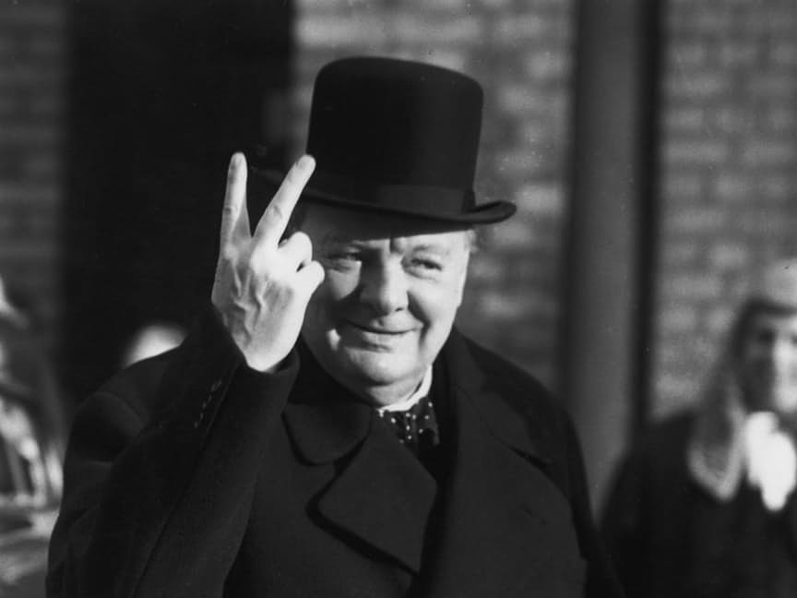

Slide 6
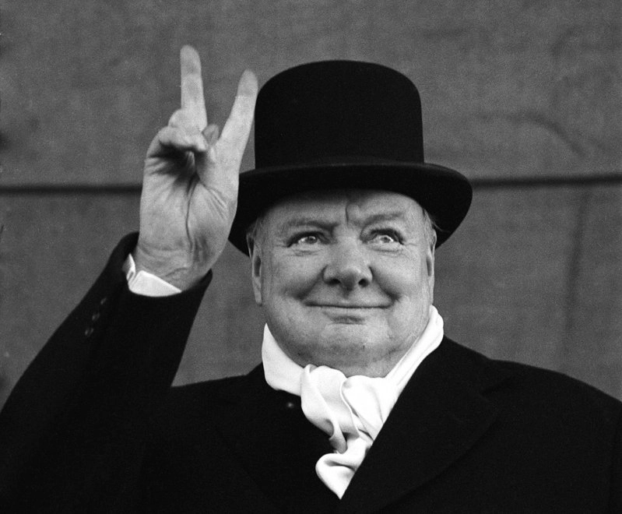

Slide 7
A LIFE OF VICTORY
A REMINDER OF A POWERFUL OPPONENT

Slide 8
A Reminder of a Powerful Opponent
“master reminder”
What is “the world”?
--a Satanically-operated system that operates to oppose God
--1John 2:15-17 “lust of the flesh…lust of the eyes…the pride of life”
**The world is not your friend, but a deceitful and destructive enemy

Slide 9
A LIFE OF VICTORY
A REMINDER OF A POWERFUL OPPONENT
A REVELATION OF A PROVIDED OUTCOME

Slide 10
A Revelation of a Provided Outcome
The Bible is a book of revelation
“overcome the world” X 3
Then why do I feel like such a loser???
**God doesn’t see you as a loser, but as “more than a conqueror” in the Son

Slide 11
A LIFE OF VICTORY
A REMINDER OF A POWERFUL OPPONENT
A REVELATION OF A PROVIDED OUTCOME
A RESOURCE FOR A PRACTICAL OVERCOMING

Slide 12
A Resource for a Practical Overcoming
The resource for victory over the world is “our faith”
--objective faith = what you believe
(the facts that you believe)
--subjective faith = that you believe
(the fact that you believe)

Slide 13
A Resource for a Practical Overcoming
The resource for victory over the world is “our faith”
2 prongs of the resource of faith
--Birth (born of God)
~ new life, inherited characteristics, recognized identity, family rights
--Belief (that Jesus is the Son of God)
~ His deity means that He…
Is in complete charge, knows best, is worthy of obedience, is able to empower me

Slide 14
A Resource for a Practical Overcoming
The resource for victory over the world is “our faith”
2 prongs of the resource of faith
--Birth (born of God)
--Belief (that Jesus is the Son of God)
**Both nature (born of God) and nurture (environment of believing) impact my practical ability to overcome the world in my daily life

Slide 15
A LIFE OF VICTORY
A REMINDER OF A POWERFUL OPPONENT
A REVELATION OF A PROVIDED OUTCOME
A RESOURCE FOR A PRACTICAL OVERCOMING
“Victory” is in your spiritual DNA…
will you commit and submit to Jesus Christ in order to experience that victory over the world today?

