Slide 1
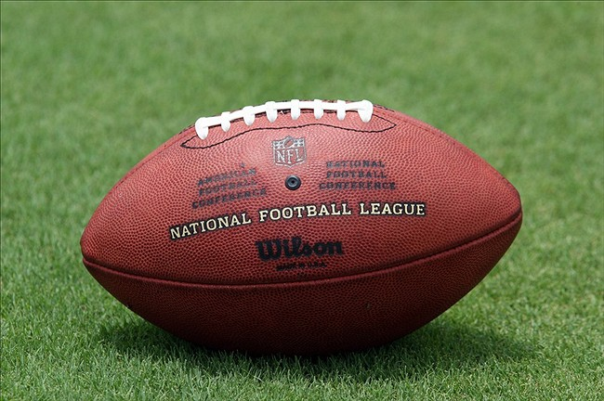

Slide 4
LAZINESS VS. DILIGENCE
Proverbs 19:24
THE SUPPER BOWL

Slide 5
SUPPER BOWL

Slide 6
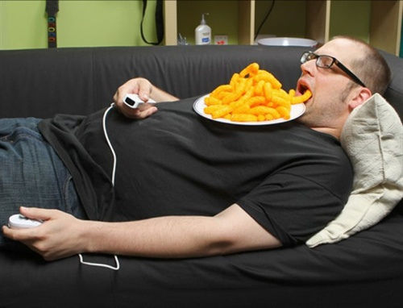
Laziness

Slide 7
Diligence

Slide 8
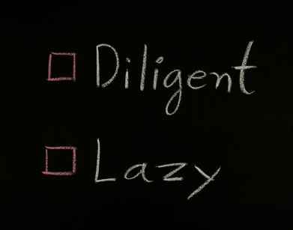
CHECK ONE:

Slide 11
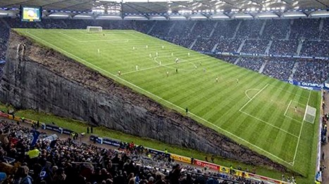
UNLEVEL PLAYING FIELD
DILIGENT
LAZY

Slide 12
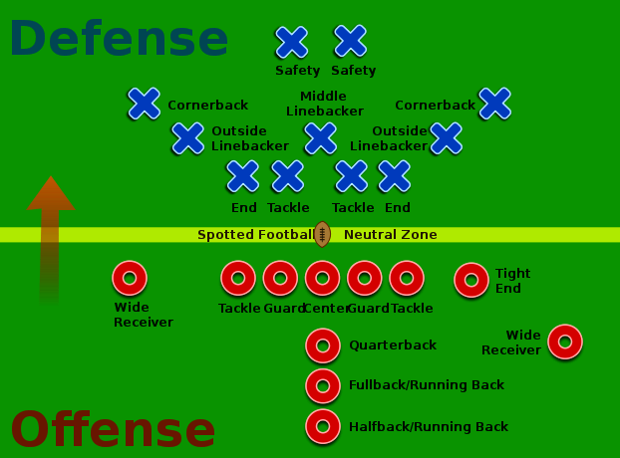

Slide 13
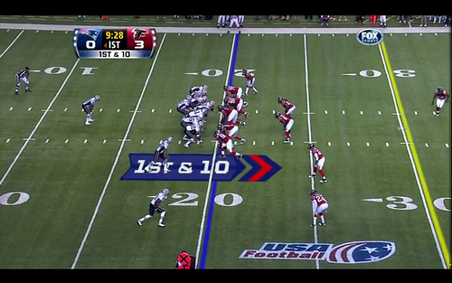

Slide 14
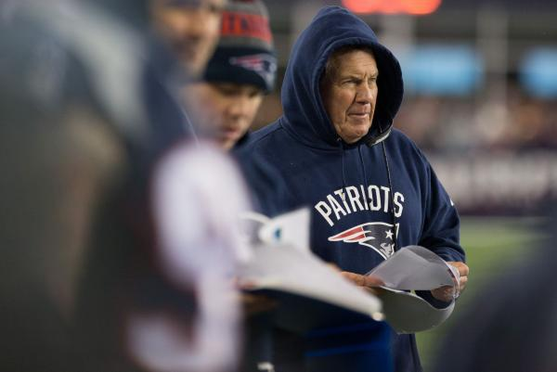
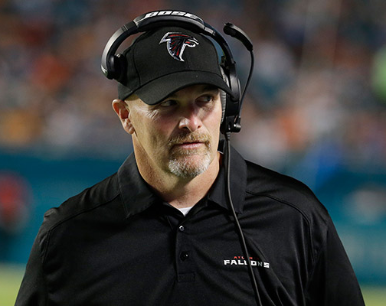
Pre-game Preparation (6:6-11)

Slide 15
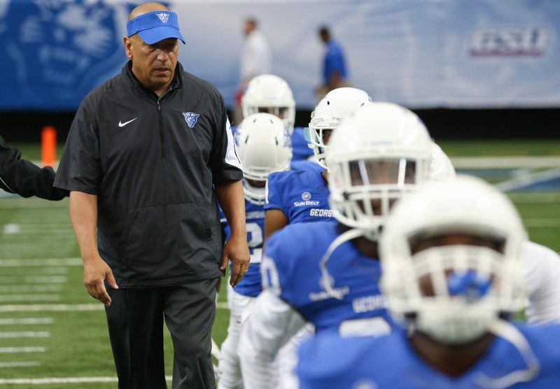
Attention to Condition (27:23)

Slide 16
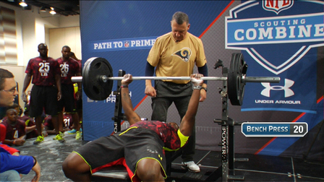
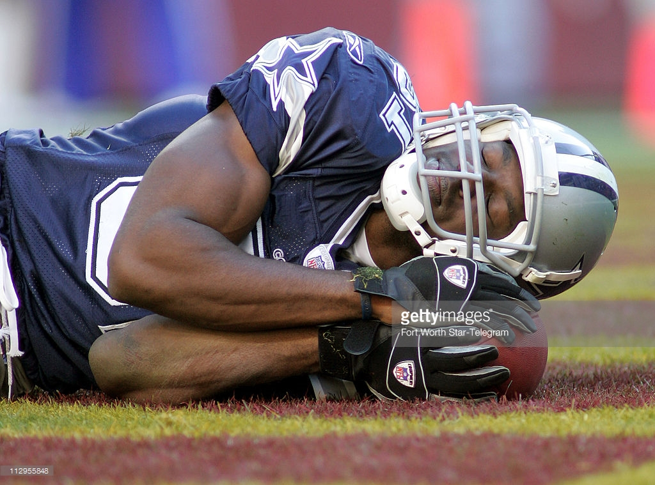
Work Leads to Satisfaction (12:11)

Slide 17
Gametime—Game Plan

Slide 18
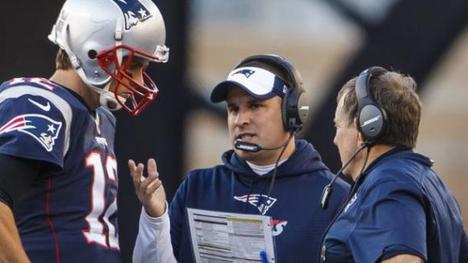
Implementing the Game Plan (21:15)

Slide 19
Gametime—Passing Game

Slide 20
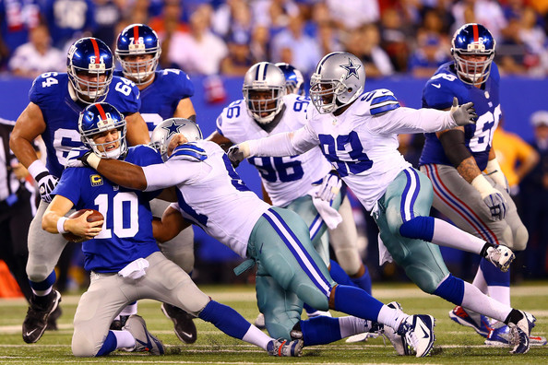
Protection Breaking Down (24:30-34)

Slide 21
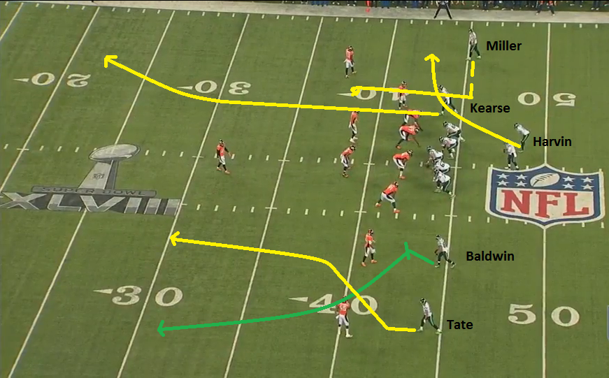

Slide 22
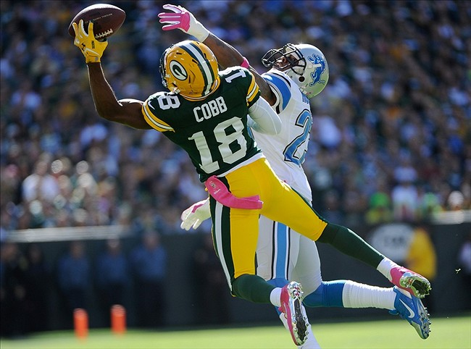
Great Hands (10:4)

Slide 23
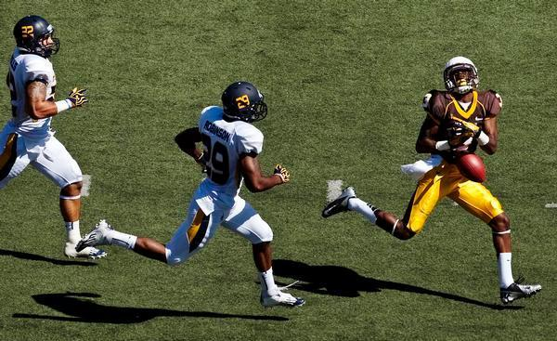
Burned by Drop (10:26)

Slide 24
Gametime—Runnig Game

Slide 25
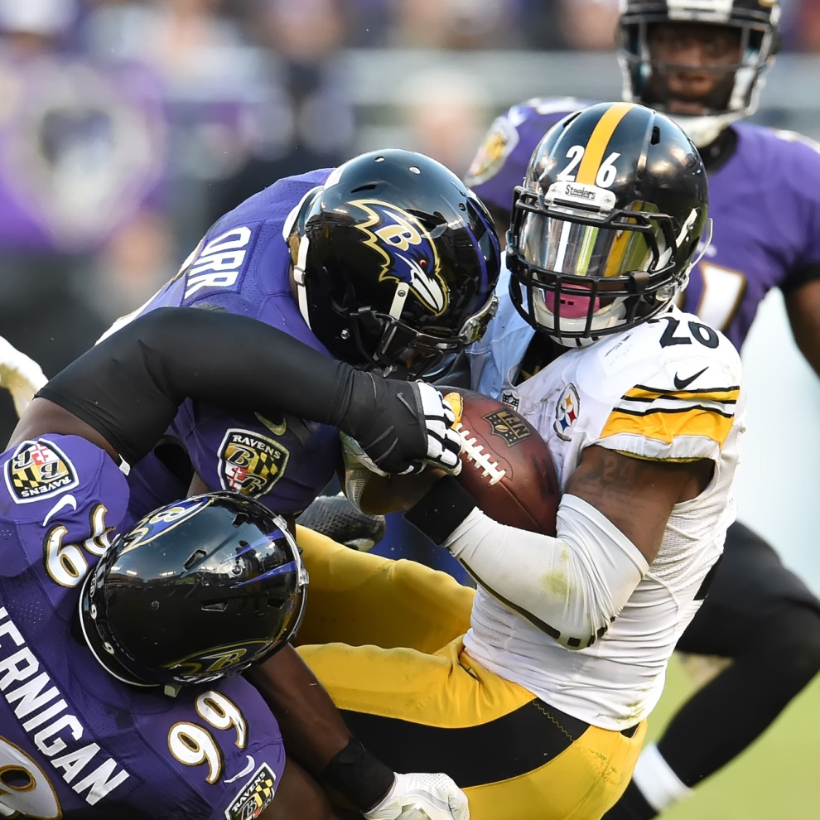
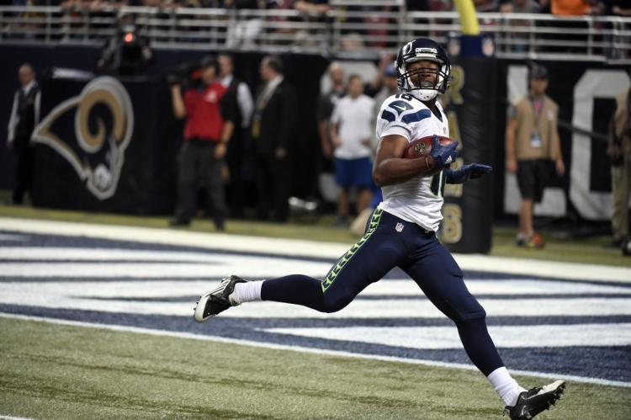
What’s Ahead? (15:19)

Slide 26
Gametime—DEFENSE

Slide 27
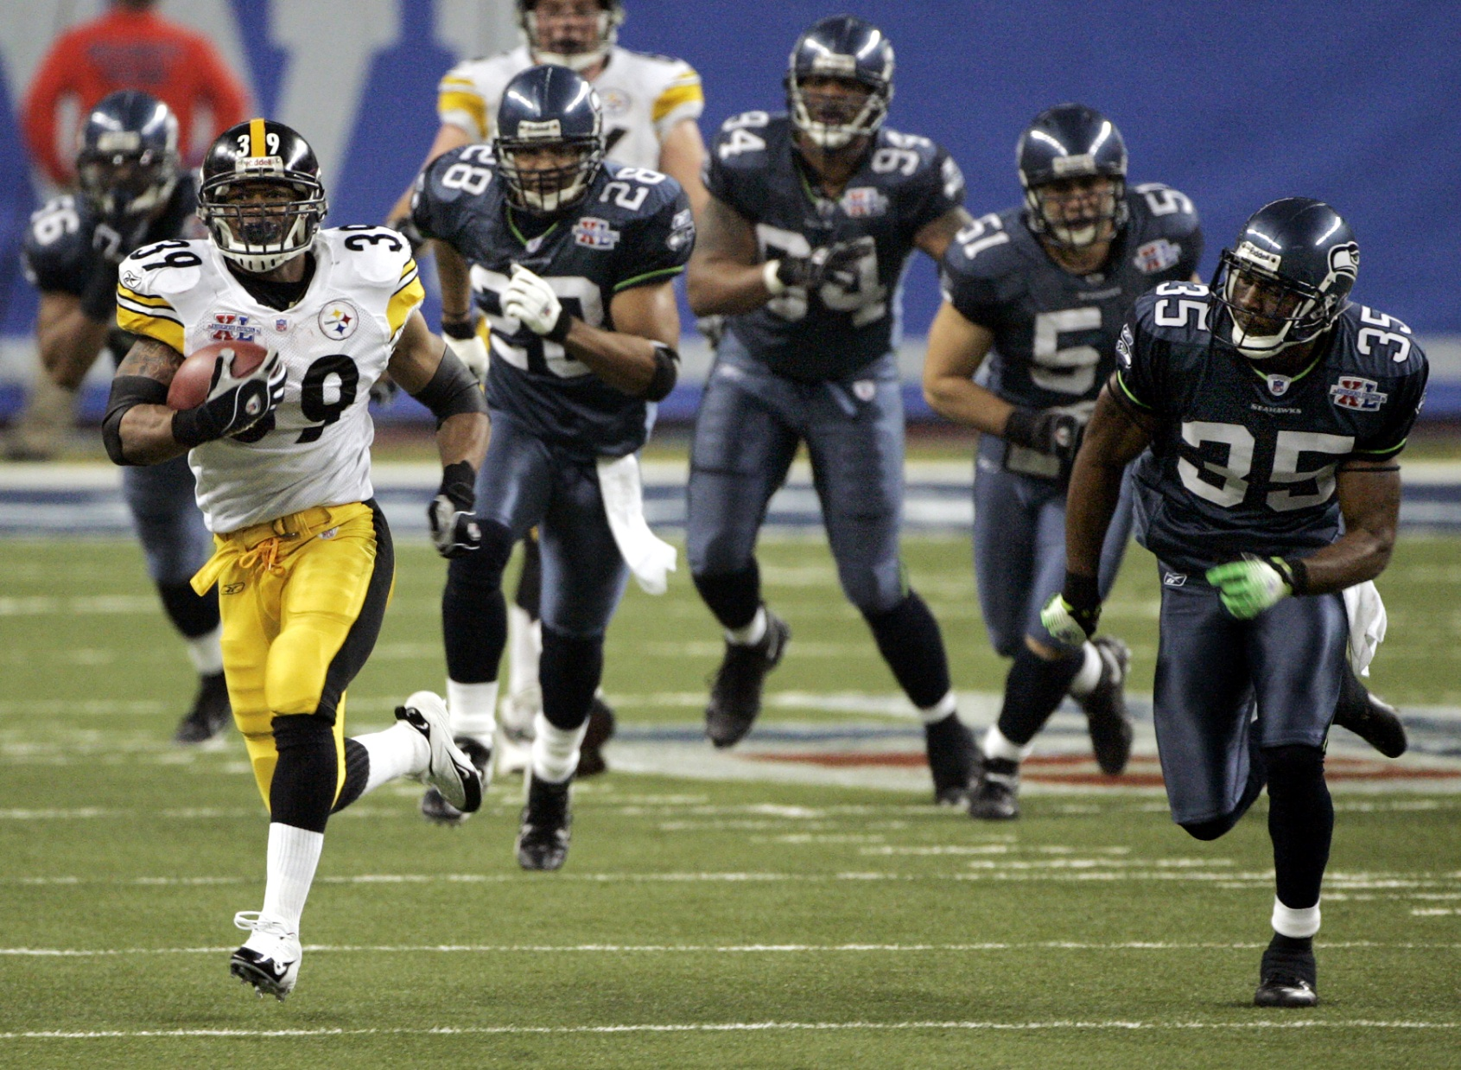
Caught Napping (19:15; 20:13)

Slide 28
Gametime—Both Sides of the Ball

Slide 29
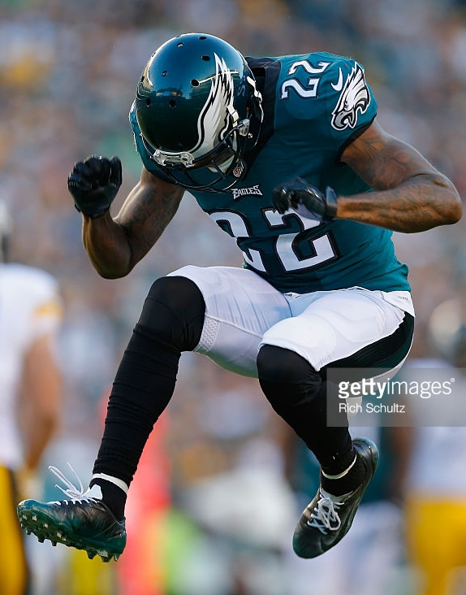
Missed Opportunities (12:27)

Slide 30
Gametime—Intangibles

Slide 31
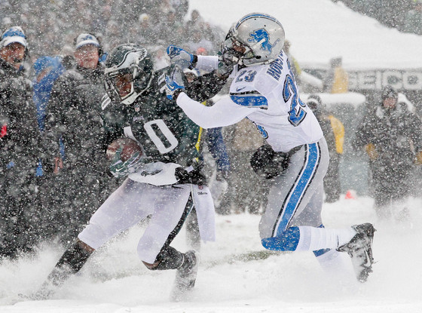
Excuses—Too Cold to Work (20:4)

Slide 32
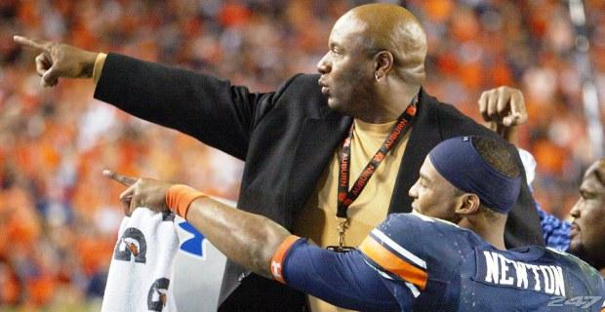
Too Dangerous Out There (22:13)

Slide 33
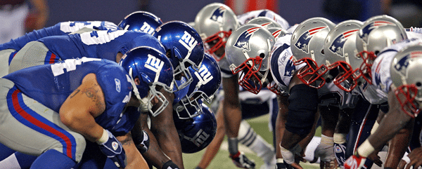
Who Wants It More? (13:4)

Slide 34
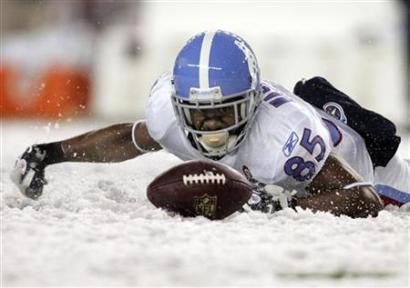
More Than Desire (21:25)

Slide 35
Post-Game

Slide 36
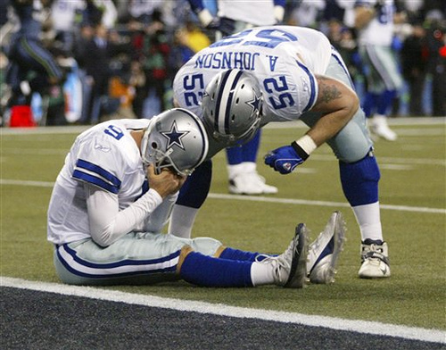
Losing Team (18:9)

Slide 37
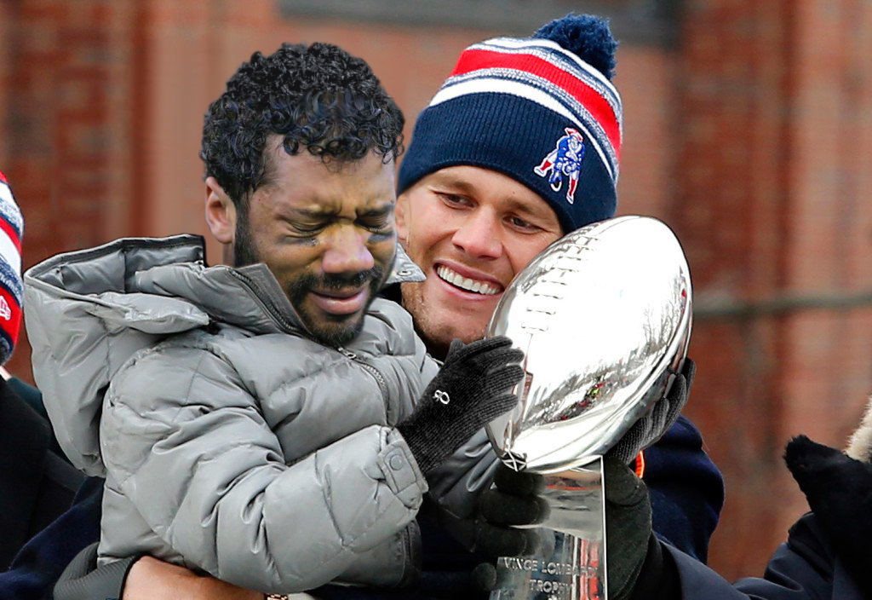
Winners and Losers (12:24)

Slide 38
LAZINESS VS. DILIGENCE IN THE SUPPER BOWL
Which team is winning in your spiritual life???

