Slide 1
PRAYER WORKS

Slide 2
2016 ELECTIONS
PRAY
BE INFORMED
PRAY
VOTE
PRAY

Slide 3
2016 ELECTIONS
PRAY
BE INFORMED
PRAY
VOTE
PRAY

Slide 5
PRAYER WORKS
PRAYER DOES WORK
PRAYER IS WORK

Slide 6
Prayer DOES Work
“The effective, fervent prayer
of a righteous man
avails much.”
(James 5:16b)
Prayer accomplishes an abundance!

Slide 7
PRAYER IS WORK
HISTORY of “Prayer is Work”
MYSTERY of “Prayer is Work”
MASTERY of “Prayer is Work”

Slide 8
Pray-ers at Work

Slide 9
MASTERY of “Prayer is Work”
Boldly appealing to the character of God (Abraham)
Tenaciously requesting the blessing of God (Jacob)
Humbly pleading for the action of God (Daniel)
Actively identifying with the need before God (Elijah)
Emotionally seeking the mercy of God (Ezra)
Earnestly sweating for the will of God

Slide 10
Earnestly sweating for the will of God
Lk 22:40-45
Jesus Christ
--agony
--more earnestly
--sweat like great drops of blood

Slide 11
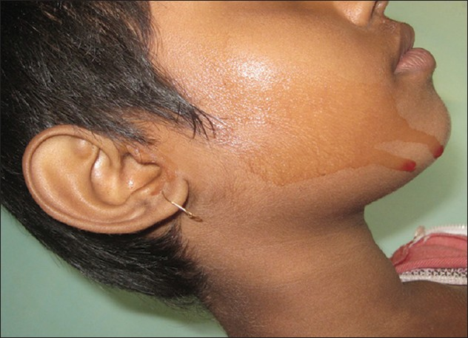

Slide 12
Corporately persevering for the intervention of God
Acts 12:5,12; Colossians 4:2; Romans 15:3
New Testament local churches
--Jerusalem
--Colosse
--Rome

Slide 13
Colosse
Continue earnestly in prayer, being vigilant in it with thanksgiving; meanwhile praying also for us, that God would open to us a door for the word, to speak the mystery of Christ, for which I am also in chains, that I may make it manifest, as I ought to speak. Colossians 4:2-4

Slide 14
Rome
Romans 12:12 rejoicing in hope, patient in tribulation, continuing steadfastly in prayer;
Romans 15:30-32 Now I beg you, brethren, through the Lord Jesus Christ, and through the love of the Spirit, that you strive together with me in prayers to God for me, that I may be delivered from those in Judea who do not believe, and that my service for Jerusalem may be acceptable to the saints, that I may come to you with joy by the will of God, and may be refreshed together with you.

Slide 15
Corporately persevering for the intervention of God
Acts 12:5,12; Colossians 4:2; Romans 15:3
New Testament local churches
--Jerusalem
--Colosse
--Rome

Slide 16
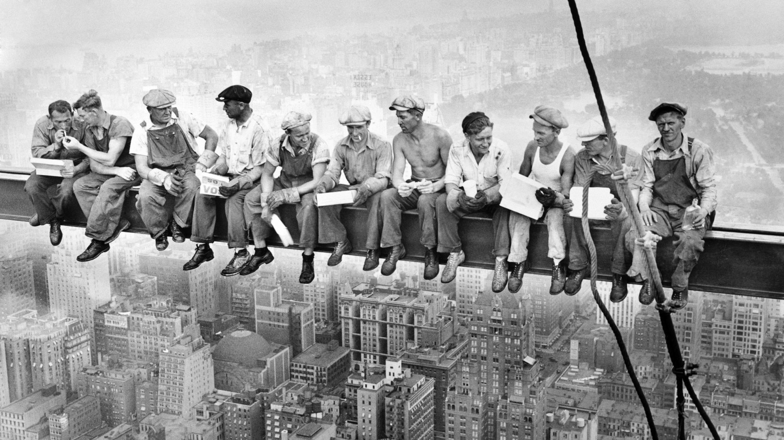
MASTERY of “Prayer is Work”
Boldly appealing to the character of God
Tenaciously requesting the blessing of God
Humbly pleading for the action of God
Actively identifying with the need before God
Emotionally seeking the mercy of God
Earnestly sweating for the will of God
Corporately persevering for the intervention of God

Slide 17
MASTERY of “Prayer is Work”
Boldly appealing to the character of God
Tenaciously requesting the blessing of God
Humbly pleading for the action of God
Actively identifying with the need before God
Emotionally seeking the mercy of God
Earnestly sweating for the will of God
Corporately persevering for the intervention of God
Fervently laboring for maturity in God

Slide 18
Fervently laboring for maturity in God
Colossians 4:12
Epaphras
--laboring fervently
--great zeal

Slide 19
MASTERY of “Prayer is Work”
Boldly appealing to the character of God (Abraham)
Tenaciously requesting the blessing of God (Jacob)
Humbly pleading for the action of God (Daniel)
Actively identifying with the need before God (Elijah)
Emotionally seeking the mercy of God (Ezra)
Earnestly sweating for the will of God (Jesus Christ)
Corporately persevering for the intervention of God (NT local churches)
Fervently laboring for maturity in God (Epaphras)

Slide 20
Good work ethic in prayer requires 3-D
DESIRE
DETERMINATION
DISCIPLINE

Slide 21
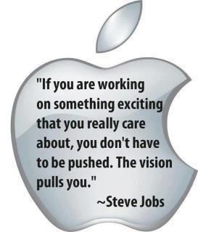
Desire = Motivation

Slide 22
Determination = decision to act

Slide 23
Discipline = perseverance

Slide 24
Good work ethic in prayer requires 3-D
DESIRE
DETERMINATION
DISCIPLINE

Slide 25
IN 2016

