Slide 1
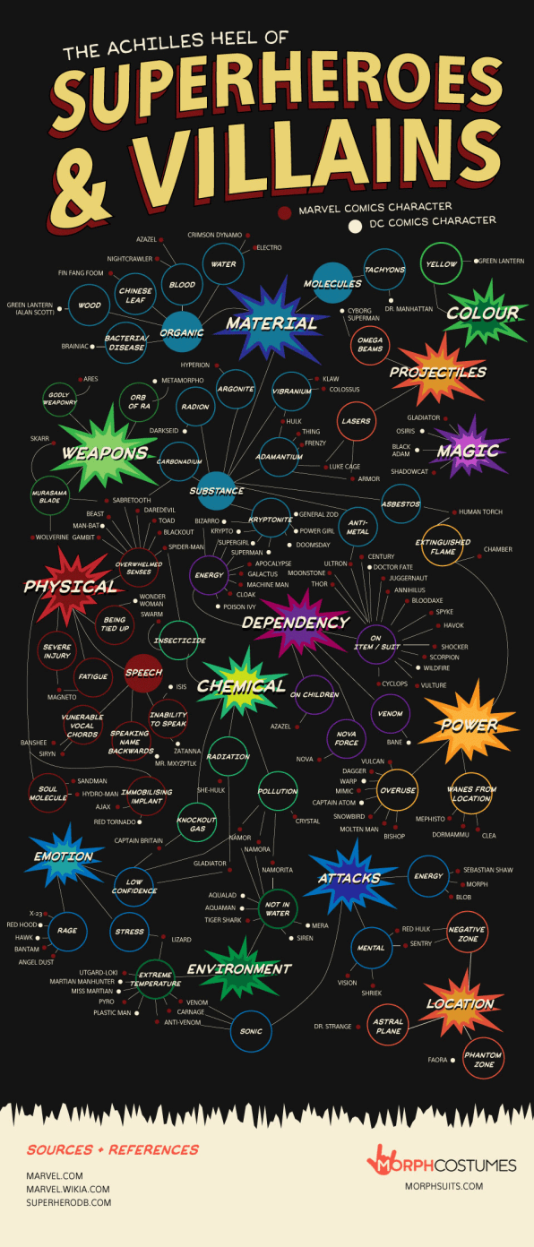

Slide 2
Arch-Enemies of the Believer
The WORLD: the anti-God system of values that underlies the cultures of man
Galatians 6:14 …the cross of our Lord Jesus Christ, by whom the world has been crucified to me, and I to the world.
The FLESH: the tendency toward sin indwelling every human being; self-life
Galatians 5:24 And those who are Christ's have crucified the flesh with its passions and desires.
The DEVIL

Slide 3
YOUR ADVERSARY THE DEVIL
1Peter 5:8-9

Slide 4
YOUR ADVERSARY THE DEVIL
A POWERFUL ADVERSARY

Slide 5
A Powerful Adversary—his identity
Devil—slanderer
Satan—adversary
Serpent—subtle
Great fiery red dragon—monstrous
Abaddon/Apollyon—destroyer
Beelzebub—lord of the house (his demons)
Belial—wicked
Ruler of this world (kosmos)
God of this age (aion)
Prince of the power of the air

Slide 6
A Powerful Adversary—his strategy
Accuses
Deceives
Tempts
Steals
Binds
Sifts
Hinders
Snares
Disguises
Shoots

Slide 7
A POWERFUL ADVERSARY
**Your adversary the devil’s identity and strategy reveal his power, and should cause you to take seriously the threat he aims against your spiritual well-being**

Slide 8
YOUR ADVERSARY THE DEVIL
A POWERFUL ADVERSARY
A TEMPORARY ADVERSARY

Slide 9
A TEMPORARY ADVERSARY
Knows he has a short time (Rev.12:12)
Crushed under our feet shortly (Rom.16:20)
Falls like lightning (Luke 10:18)
Cast out (John 12:31)
Judged (John 16:11)
Destroyed (Heb.2:14)
Rebuked (Zec.3:2; Jude v.9)
Condemned (1Tim. 3:6)
Bound (Rev.20:2-3)
Cast into the lake of fire (Mt.25:41; Rev.20:10)

Slide 10
A TEMPORARY ADVERSARY
**God assures us that there is an end in sight in our battle with our adversary the devil, so we should always persevere for another day**

Slide 11
YOUR ADVERSARY THE DEVIL
A POWERFUL ADVERSARY
A TEMPORARY ADVERSARY
A VULNERABLE ADVERSARY

Slide 12
A VULNERABLE ADVERSARY
Our adversary the devil is vulnerable to the believer who implements God’s warfare strategies
Be ALERT (1Peter 5:8)—sober & vigilant
Be ACTIVE (1Peter 5:9)—resistance
Be ALARMED (Ephesians 4:27)—no place
Be ARMED (Ephesians 6:11-18)—armor of God

Slide 13
A VULNERABLE ADVERSARY
**Rather than fighting according to our own wisdom, true wisdom is demonstrated in consistently employing the strategies our Lord provides for battling with our adversary the devil**

Slide 14
YOUR ADVERSARY THE DEVIL
A POWERFUL ADVERSARY
A TEMPORARY ADVERSARY
A VULNERABLE ADVERSARY
**In what way(s) is your adversary the devil making inroads into your life?
**How will you better implement the strategies of being alert, active, alarmed, and armed as you do battle with him?

