Slide 1
DISPLAYING HIS GRACE
John 1:14-17

Slide 2
DISPLAYING HIS GRACE
HIS GRACE IS EQUAL WITH TRUTH (v.14)
“full of grace and truth”

Slide 3
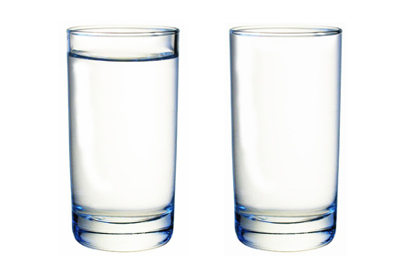
nearly full full

Slide 5
DISPLAYING HIS GRACE
HIS GRACE IS EQUAL WITH TRUTH (v.14)
“full of grace and truth”
In an atmosphere of PRIORITY

Slide 6
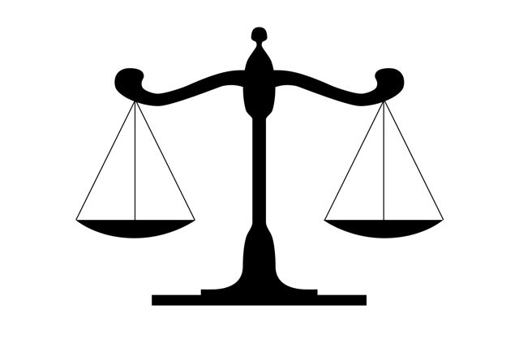
BALANCING GRACE and TRUTH

Slide 7
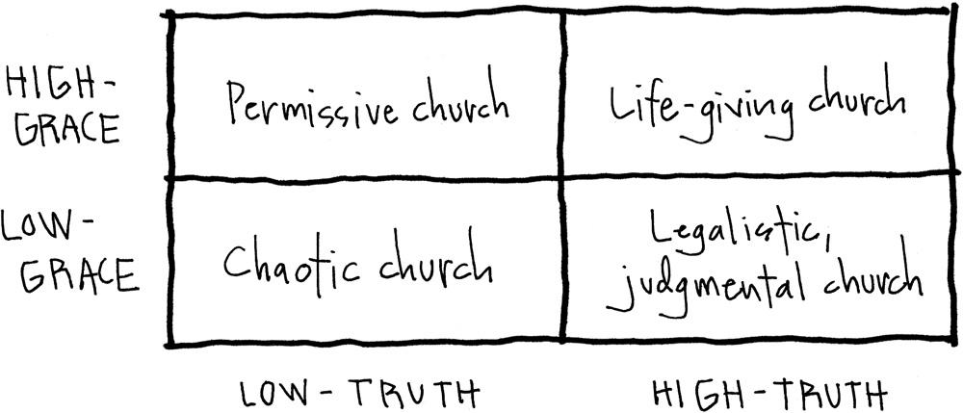

Slide 8
DISPLAYING HIS GRACE
HIS GRACE IS EQUAL WITH TRUTH (v.14)
“full of grace and truth”
In an atmosphere of PRIORITY
As the Lord Jesus was FULL of grace AND truth, we should be also
I should be careful to emphasize grace toward others as a Biblical priority

Slide 9
DISPLAYING HIS GRACE
His grace is equal with truth (v.14)
His grace is overflowing with grace (v.16)

Slide 10
DISPLAYING HIS GRACE
HIS GRACE IS OVERFLOWING WITH GRACE (v.16)
“grace for grace”

Slide 11
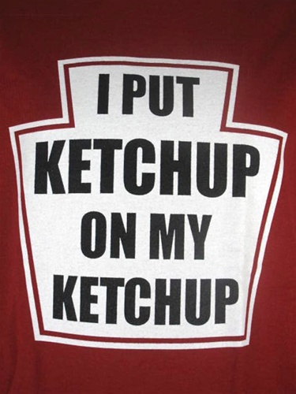

Slide 12
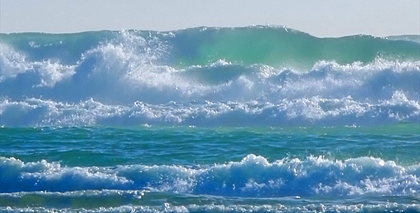

Slide 13
DISPLAYING HIS GRACE
HIS GRACE IS OVERFLOWING WITH GRACE (v.16)
“grace for grace”
In an atmosphere of GENEROSITY
As the Lord Jesus generously bestows grace on me, my grace toward others should overflow
I should be proactively and intentionally looking for ways to pour out more and more grace on others

Slide 14
DISPLAYING HIS GRACE
His grace is equal with truth (v.14)
His grace is overflowing with grace (v.16)
His grace is contrasted with law (v.17)

Slide 15
DISPLAYING HIS GRACE
HIS GRACE IS CONTRASTED WITH LAW (v.17)
“the law was given…grace and truth came…”

Slide 16
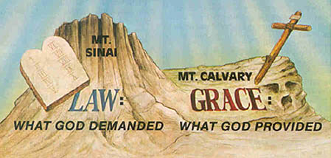

Slide 18
DISPLAYING HIS GRACE
HIS GRACE IS CONTRASTED WITH LAW (v.17)
“the law was given…grace and truth came…”
In an atmosphere of HUMILITY
Am I known as judgmental or gracious in truth?
His grace doesn’t give the judgment and condemnation deserved, but rather offers the blessing that is undeserved

Slide 19
DISPLAYING HIS GRACE
His grace is equal with truth in an atmosphere of priority
His grace is overflowing with grace in an atmosphere of generosity
His grace is contrasted with law in an atmosphere of humility

Slide 20
Are we, as a church, displaying His grace?
Am I, as an individual,
displaying His grace?

