Slide 1
BEARING ONE ANOTHER’S BURDENS
Galatians 6:2

Slide 3
What does it mean to bear burdens?
What constitutes a burden?
--v.2 burden noted for its excessive weight
--v.5 burden noted as an appropriate load

Slide 4
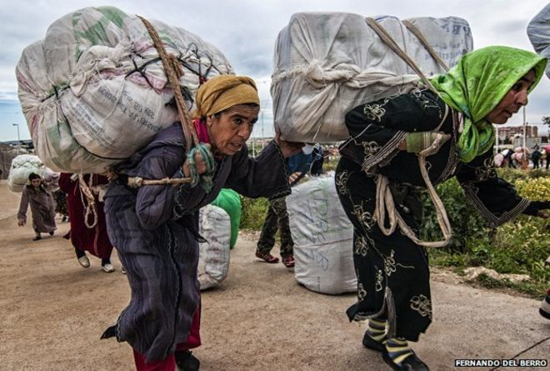

Slide 5
What does it mean to bear burdens?
What constitutes a burden?
--v.2 burden noted for its excessive weight
--v.5 burden noted as an appropriate load
What are some real-life burdens?

Slide 6
Real life burdens
-spiritual burdens
-mental burdens
-emotional burdens
-physical burdens
-relational burdens
-financial burdens

Slide 7
What does it mean to bear burdens?
What constitutes a burden?
What are some real-life burdens?
Bear = pick up and carry
**Will you ask the Lord to burden your heart for other believers who are carrying excessive burdens?

Slide 8
How can we be prepared to bear burdens?
Spirituality
Gentleness
Humility
Love
Honesty
Responsibility
**Which of these attributes need to be developed in me?

Slide 9
What are practical ways to bear burdens?

Slide 10
What are practical ways to bear burdens?
Principles to have in mind
-Understand that every believer has burdens
-Be willing to have others help me
-Don’t be a burden-binder
-Burden-bearing is a team effort
-Burden-bearing is NOT enabling
-Burden-bearing will take your shape
-Burden-bearing requires sacrifice

Slide 11
What are practical ways to bear burdens?
Listen
Encouraging words
Share Scripture
Pray for and with
Give materially
Share own experience
Answer questions
Remove duties
Teach
Presence
Physical touch
Empathize

Slide 12
What are practical ways to bear burdens?
**What commitment will you make right now regarding bearing the burdens of one another?

