Slide 1
GREETING ONE ANOTHER
Romans 16:16

Slide 2
GREET ONE ANOTHER
Greet one another with a holy kiss. (Rom 16:16)
Greet one another with a holy kiss. (1Cor 16:20)
Greet one another with a holy kiss. (2Cor 13:12)
Greet all the brethren with a holy kiss. (1Th 5:26)
Greet one another with a kiss of love. (1Pe 5:14)

Slide 3
PURPOSE OF GREETING ONE ANOTHER
Definition—”aspazomai”: to draw to oneself
Mark of relationship
Family
Opportunity for expression/communication of:

Slide 4
Expression of:
Acknowledgement—“I acknowledge you”
Attention—“I choose to focus on you”
Affirmation—“You have importance to me”
Acceptance—“I want to interact with you”
Appreciation—“I am thankful for you”
Affection—“I want the best for you”

Slide 5
PURPOSE OF GREETING ONE ANOTHER
Definition—”aspazomai”: to draw to oneself
Mark of relationship
Family
Opportunity for expression/communication
**As fellow-believers, we are to intentionally greet with a desire to be in closer fellowship with each other

Slide 6
PATTERN OF GREETING ONE ANOTHER
New Testament-patterned church
Is the pattern the greeting or the kiss?

Slide 7
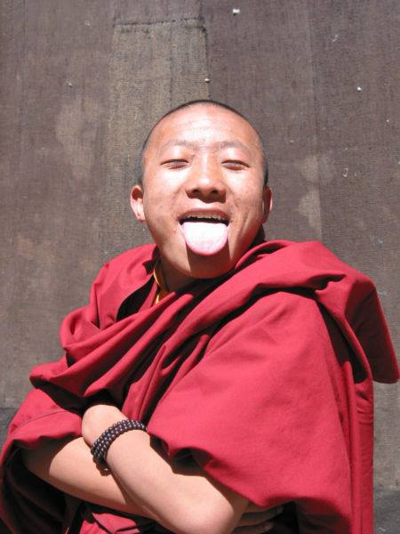
TIBET—STICKING OUT THE TONGUE

Slide 8
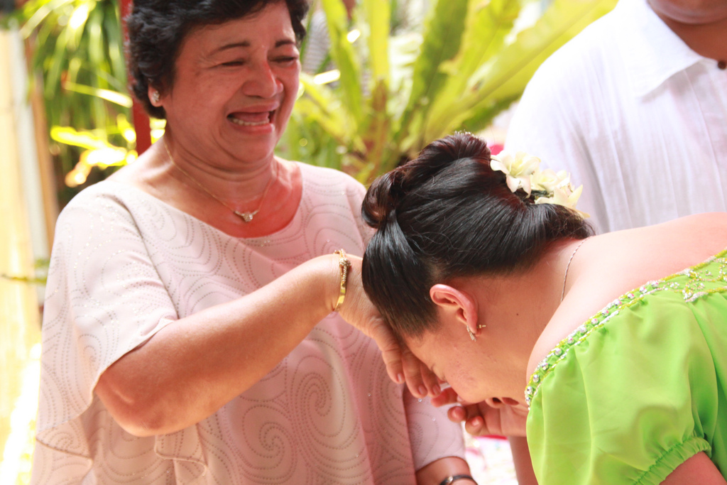
PHILIPPINES—MANO

Slide 9
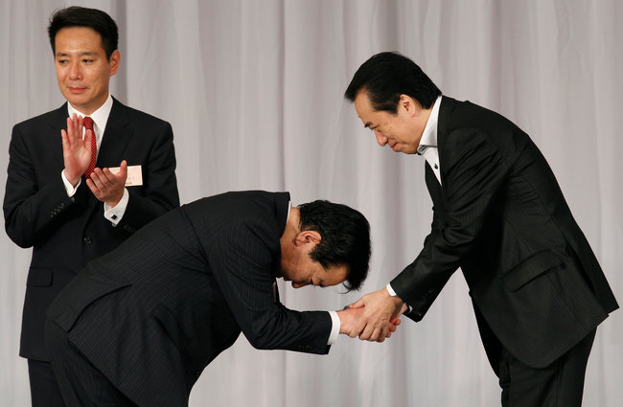
JAPAN—BOWING

Slide 10
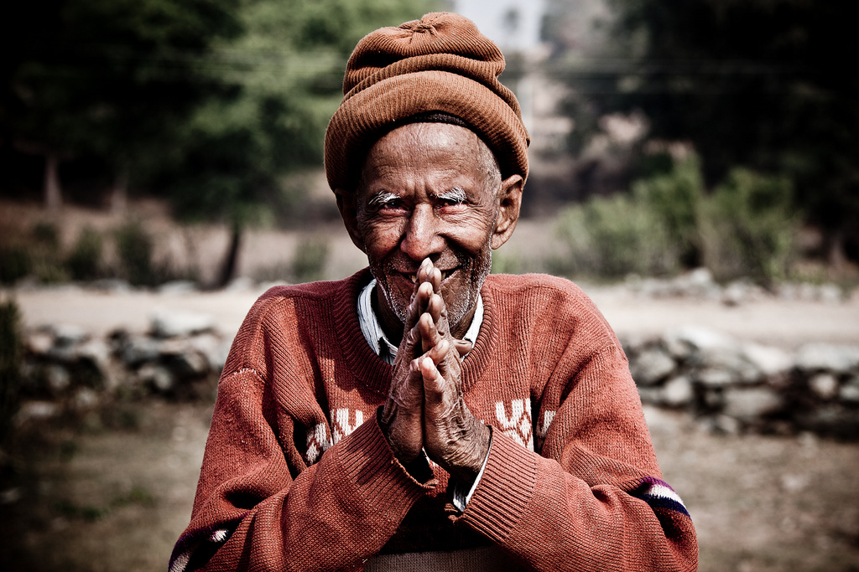
INDIA—NAMASTE

Slide 11
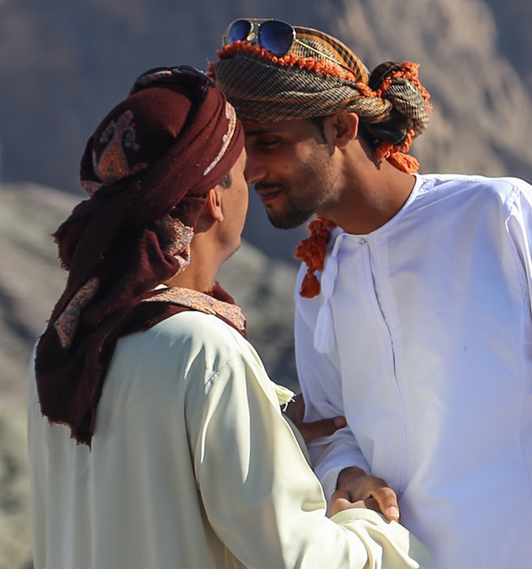
OMAN—NOSE “KISSES”

Slide 12
NEW ZELAND—HONGI

Slide 13
MALAYSIA—FINGERTIPS/HEART

Slide 14
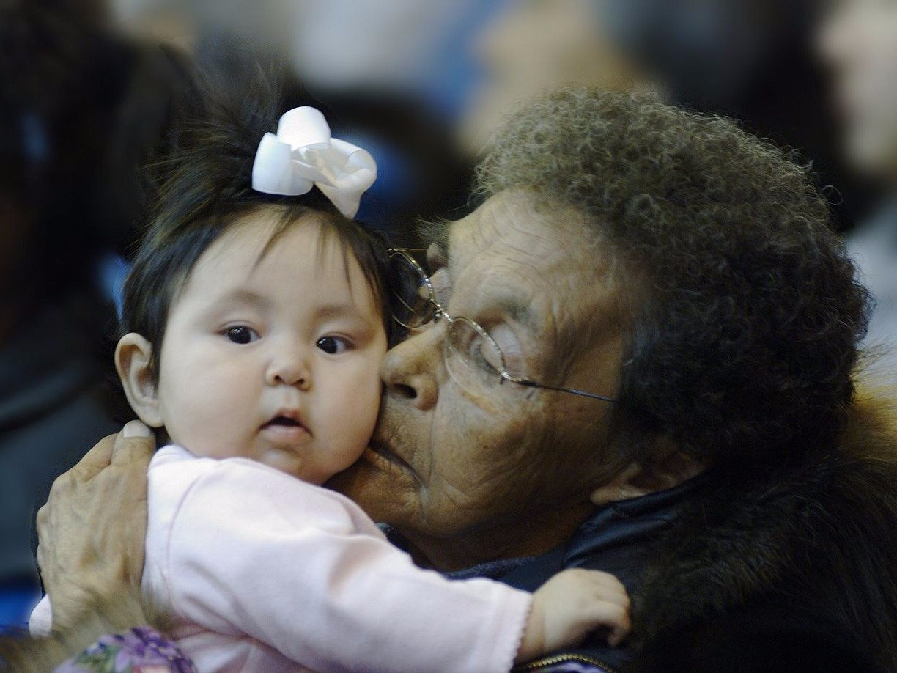
GREENLAND—KUNIK

Slide 15
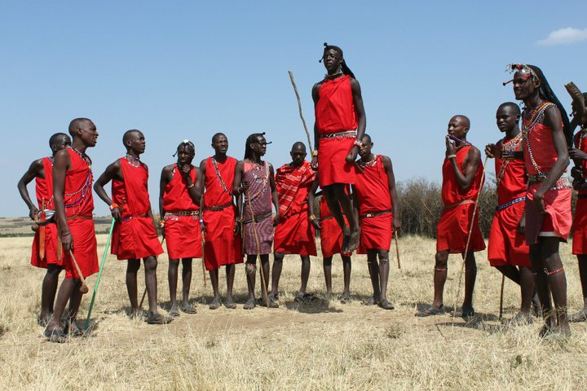
KENYA—ADAMU

Slide 16
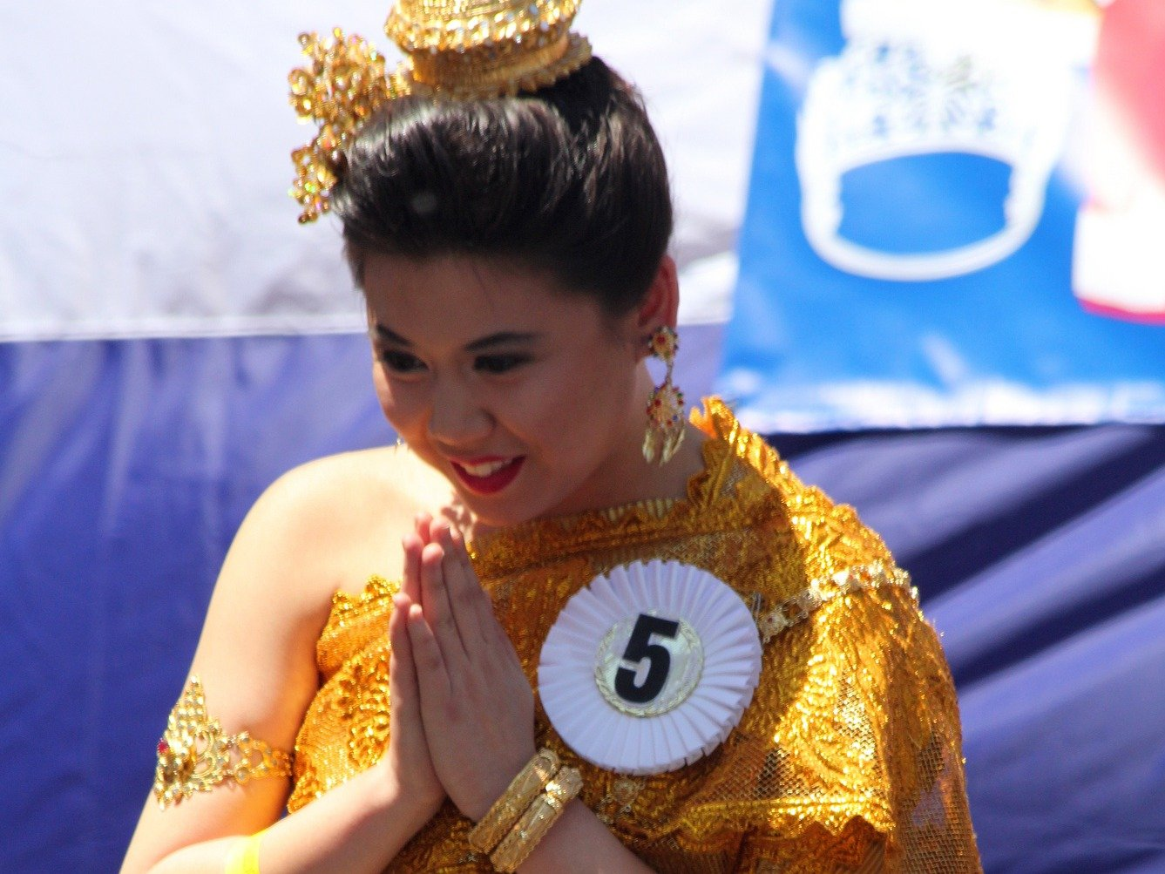
THAILAND—WAI

Slide 17
PATTERN OF GREETING ONE ANOTHER
New Testament-patterned church
Is the pattern the greeting or the kiss?
Appropriate cultural greeting—handshake/touch/hug
**The New Testament pattern of a physical expression of greeting is not intended to be a legalistic duty, but a joyful privilege

Slide 18
PRACTICE OF GREETING ONE ANOTHER
Hindrances to greeting one another
--distraction (Lk.10:40)
--self-focus (Gal.5:24-25)
--shyness (Eph.3:20)
--insecurity (Phil.4:6-7)
--fear (Mark 5:36)
--grudges, hard feelings (Matt.5:24)

Slide 19
PRACTICE OF GREETING ONE ANOTHER
Helps in greeting one another with greetings that are:
--sanctified
--sincere
--sensitive
**Practical greeting is practical giving

Slide 20
GREET ONE ANOTHER

