Slide 1
TO BE WISE, SHOULD I SUPERSIZE OR MINIMIZE?
Pride and Humility in Proverbs

Slide 2
HUMILITY AND PRIDE, SIDE BY SIDE
Pride = supersizing myself
--Hebrew words emphasizing exaltation, height
God’s view
--He hates pride (6:16-17)
--He is disgusted by pride (16:5; 6:16-17)
--He identifies pride as sin (21:4)
--He mocks the prideful (21:24; 3:34)

Slide 3
HUMILITY AND PRIDE, SIDE BY SIDE
Humility = minimizing myself
--Hebrew words emphasizing lowliness
God’s view
--He gives grace to the humble (3:34)

Slide 4
“True humility is not thinking less of yourself; it is thinking of yourself less.” (C.S. Lewis, Mere Christianity)

Slide 5
EVENTUAL DESTINATION
Pride results in:
Humility results in:
Shame (11:2)
Strife (13:10; 28:25)
Destruction (15:25; 16:18)
Falling (16:18)
Lowliness (29:23)
In Christ’s economy, the way up
Wisdom (11:2; 13:10)
Honor (15:33; 29:23; 22:4)
Riches (22:4)
Life (22:4)
Prosperity (28:25)
is down…and vice versa

Slide 6
MISSION IMPOSSIBLE— WITHOUT HUMILITY, YOU CAN’T BE A
SERVANT, laboring for the Lord and other

Slide 7
LABORING SERVANT

Slide 8
MISSION IMPOSSIBLE— WITHOUT HUMILITY, YOU CAN’T BE A
SERVANT, laboring for the Lord and others
SUBMITTER, leaning on the Lord and others

Slide 9
LEANING SUBMITTER

Slide 10
MISSION IMPOSSIBLE— WITHOUT HUMILITY, YOU CAN’T BE A
SERVANT, laboring for the Lord and others
SUBMITTER, leaning on the Lord and others
SUPPORTER, lifting up the Lord and others

Slide 11
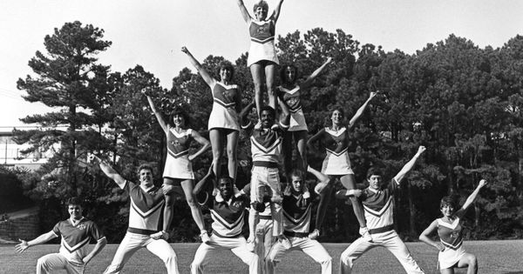
LIFTING SUPPORTER

Slide 12
MISSION IMPOSSIBLE— WITHOUT HUMILITY, YOU CAN’T BE A
SERVANT, laboring for the Lord and others
SUBMITTER, leaning on the Lord and others
SUPPORTER, lifting up the Lord and others
STUDENT, learning from the Lord and others

Slide 13
LEARNING STUDENT

Slide 14
MISSION IMPOSSIBLE— WITHOUT HUMILITY, YOU CAN’T BE A
SERVANT, laboring for the Lord and others
SUBMITTER, leaning on the Lord and others
SUPPORTER, lifting up the Lord and others
STUDENT, learning from the Lord and others

Slide 15
TO BE WISE, MINIMIZE
Pride and Humility in Proverbs

