Slide 2
BOLD IN YOUR BELIEFS
TRUTH is what it is. Belief is what you turn it into

Slide 3
Levels of Philosophy
BEHAVIOR
TRUTH in
Practice
CHOICES
BELIEF
TRUTH in Thought:
Values Ethics
EXPERIENCE
FEELING – EMOTION
TRUTH
No Ambiguity
LOGIC
kjp/rzim
Notes:
I is absolute truth which has to be absolute and unchangeable
II is how we feel about things – our preferences – but must be based on truth or it is only an opinion
III is how we live day by day – but it must be based on truth rather than emotion and feeling

Slide 4
Levels of Philosophy
BEHAVIOR
TRUTH in
Practice
CHOICES
BELIEF
TRUTH in Thought:
Values Ethics
EXPERIENCE
FEELING – EMOTION
TRUTH
No Ambiguity
LOGIC
kjp/rzim
Notes:
I is absolute truth which has to be absolute and unchangeable
II is how we feel about things – our preferences – but must be based on truth or it is only an opinion
III is how we live day by day – but it must be based on truth rather than emotion and feeling

Slide 5
Levels of Philosophy
BEHAVIOR
TRUTH in
Practice
CHOICES
If we say that we have fellowship with Him and yet walk in the darkness, we lie and do not practice the truth; (1Jn 1:6 NASB)
kjp/rzim
Notes:
I is absolute truth which has to be absolute and unchangeable
II is how we feel about things – our preferences – but must be based on truth or it is only an opinion
III is how we live day by day – but it must be based on truth rather than emotion and feeling

Slide 6
Levels of Philosophy
BEHAVIOR
TRUTH in
Practice
CHOICES
BELIEF
TRUTH in Thought:
Values Ethics
EXPERIENCE
FEELING – EMOTION
Belief is not the truth but must be true.
Eve: Satan changed her belief a second time
Is your belief based on someone else's knowledge and experience?? Or is it based on truth?
kjp/rzim
Notes:
I is absolute truth which has to be absolute and unchangeable
II is how we feel about things – our preferences – but must be based on truth or it is only an opinion
III is how we live day by day – but it must be based on truth rather than emotion and feeling

Slide 7
And out of the ground made the LORD God to grow every tree that is pleasant to the sight, and good for food; the tree of life also in the midst of the garden, and the tree of knowledge of good and evil.
(Gen 2:9 KJV)
And the LORD God commanded the man, saying, Of every tree of the garden thou mayest freely eat: But of the tree of the knowledge of good and evil, thou shalt not eat of it: for in the day that thou eat thereof thou shalt surely die. And the LORD God said, It is not good that the man should be alone; I will make him an help meet for him. And out of the ground the LORD God formed every beast of the field, and every fowl of the air; and brought them unto Adam to see what he would call them: and whatsoever Adam called every living creature, that was the name thereof.
(Gen 2:16-19 KJV)

Slide 8
And the woman said unto the serpent, We may eat of the fruit of the trees of the garden: But of the fruit of the tree which is in the midst of the garden, God hath said, Ye shall not eat of it, neither shall ye touch it, lest ye die. (Gen 3:2-3 KJV)
And the serpent said unto the woman, Ye shall not surely die: For God doth know that in the day ye eat thereof, then your eyes shall be opened, and ye shall be as gods, knowing good and evil. (Gen 3:4-5 KJV)
And when the woman saw that the tree was good for food, and that it was pleasant to the eyes, and a tree to be desired to make one wise, she took of the fruit thereof, and did eat, and gave also unto her husband with her; and he did eat. (Gen 3:6 KJV)

Slide 9
Levels of Philosophy
BEHAVIOR
TRUTH in
Practice
CHOICES
BELIEF
TRUTH in Thought:
Values Ethics
EXPERIENCE
FEELING – EMOTION
Eve: Satan changed her belief a second time
7th Day Adventism: Same book of Daniel – 70 weeks terminates in A.D. 36
kjp/rzim
Notes:
I is absolute truth which has to be absolute and unchangeable
II is how we feel about things – our preferences – but must be based on truth or it is only an opinion
III is how we live day by day – but it must be based on truth rather than emotion and feeling

Slide 10
Immediately after the tribulation of those days shall the sun be darkened, and the moon shall not give her light, and the stars shall fall from heaven, and the powers of the heavens shall be shaken: (Mat 24:29 KJV)
This did not happen in A.D. 36!!

Slide 11
Levels of Philosophy
BEHAVIOR
TRUTH in
Practice
CHOICES
BELIEF
TRUTH in Thought:
Values Ethics
EXPERIENCE
FEELING – EMOTION
Eve: Satan changed her belief a second time
7th Day Adventism: Same book of Daniel – 70 weeks terminates in 1926
Jacob Arminius, John Calvin: Free will of man and the sovereignty of God
kjp/rzim
Notes:
I is absolute truth which has to be absolute and unchangeable
II is how we feel about things – our preferences – but must be based on truth or it is only an opinion
III is how we live day by day – but it must be based on truth rather than emotion and feeling

Slide 12
Divine sovereignty
Knowing, brethren beloved, your election of God. (1Th 1:4 KJV)
No man can come to me, except the Father which hath sent me draw him: and I will raise him up at the last day. (Joh 6:44 KJV)
Free will
And I, if I be lifted up from the earth, will draw all men unto me.
(Joh 12:32 KJV)
For God so loved the world, that he gave his only begotten Son, that whosoever believeth in him should not perish, but have everlasting life. (Joh 3:16 KJV)
Two men. Two beliefs. One Truth.

Slide 13
Levels of Philosophy
BEHAVIOR
TRUTH in
Practice
CHOICES
BELIEF
TRUTH in Thought:
Values Ethics
EXPERIENCE
FEELING – EMOTION
Eve: Satan changed her belief a second time
7th Day Adventism: Same book of Daniel – 70 weeks terminates in 1926
Jacob Arminius, John Calvin: Free will of man and the sovereignty of God
Historical-grammatical - - - Historical-critical
kjp/rzim
Notes:
I is absolute truth which has to be absolute and unchangeable
II is how we feel about things – our preferences – but must be based on truth or it is only an opinion
III is how we live day by day – but it must be based on truth rather than emotion and feeling

Slide 14
Historical-grammatical
The Bible IS the word of God - Absolute truth
. . . that from childhood you have known the sacred writings which are able to give you the wisdom that leads to salvation through faith which is in Christ Jesus. All Scripture is inspired by God and profitable for teaching, for reproof, for correction, for training in righteousness; so that the man of God may be adequate, equipped for every good work.
(2Ti 3:15-17 NASB)
Historical-critical
Bible is not THE word of God but only contains the word of God
Man determines which are the words of God requiring man to be as gods more knowledgeable than God Himself
But I am afraid that, as the serpent deceived Eve by his craftiness, your minds will be led astray from the simplicity and purity of devotion to Christ.
(2Co 11:3 NASB)

Slide 15
Levels of Philosophy
BEHAVIOR
TRUTH in
Practice
CHOICES
BELIEF
TRUTH in Thought:
Values Ethics
EXPERIENCE
FEELING – EMOTION
TRUTH
No Ambiguity
LOGIC
kjp/rzim
Notes:
I is absolute truth which has to be absolute and unchangeable
II is how we feel about things – our preferences – but must be based on truth or it is only an opinion
III is how we live day by day – but it must be based on truth rather than emotion and feeling

Slide 16
READ IT
Then study it
Then read it again . . . and . . .again . . .

Slide 17
Is 30:10
2 Cor 12:7
Acts 20:27
Gen 1:31
Ro 1:20
Ro 11:33-36
Eph 3:18-19

Slide 18
Oh, the depth of the riches both of the wisdom and knowledge of God! How unsearchable are His judgments and unfathomable His ways! For WHO HAS KNOWN THE MIND OF THE LORD, OR WHO BECAME HIS COUNSELOR? Or WHO HAS FIRST GIVEN TO HIM THAT IT MIGHT BE PAID BACK TO HIM AGAIN? For from Him and through Him and to Him are all things. To Him be the glory forever. Amen. (Rom 11:33-36 NASB)
Because of the surpassing greatness of the revelations, for this reason, to keep me from exalting myself, there was given me a thorn in the flesh, a messenger of Satan to torment me--to keep me from exalting myself! (2Co 12:7 NASB)
. . . may be able to comprehend with all the saints what is the breadth and length and height and depth, and to know the love of Christ which surpasses knowledge, that you may be filled up to all the fullness of God. (Eph 3:18-19 NASB)

Slide 19
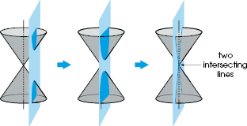

Slide 23
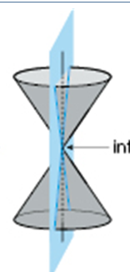

Slide 24
∞
∞
∞
∞

Slide 25
∞
∞
∞
∞

Slide 27
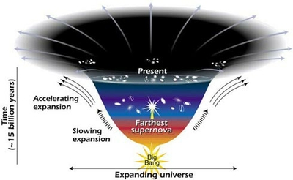

Slide 28
More is unknown than is known. We know how much dark energy there is because we know how it affects the Universe's expansion. Other than that, it is a complete mystery.
But it is an important mystery. It turns out that roughly 68% of the Universe is dark energy. Dark matter makes up about 27%. The rest - everything on Earth, everything ever observed with all of our instruments, all normal matter - adds up to less than 5% of the Universe. Come to think of it, maybe it shouldn't be called "normal" matter at all, since it is such a small fraction of the Universe.

Slide 29
Is 30:10
2 Cor 12:7
Acts 20:27
Gen 1:31
Ro 1:20
Ro 11:33-36
Eph 3:18-19

Slide 30
Levels of Philosophy
BELIEF
TRUTH in Thought:
Values Ethics
EXPERIENCE
FEELING – EMOTION
TRUTH
No Ambiguity
LOGIC
kjp/rzim
Notes:
I is absolute truth which has to be absolute and unchangeable
II is how we feel about things – our preferences – but must be based on truth or it is only an opinion
III is how we live day by day – but it must be based on truth rather than emotion and feeling

Slide 31
Levels of Philosophy
BELIEF
TRUTH in Thought:
Values Ethics
EXPERIENCE
FEELING – EMOTION
TRUTH
No Ambiguity
LOGIC
kjp/rzim
Notes:
I is absolute truth which has to be absolute and unchangeable
II is how we feel about things – our preferences – but must be based on truth or it is only an opinion
III is how we live day by day – but it must be based on truth rather than emotion and feeling

Slide 32
Levels of Philosophy
BEHAVIOR
TRUTH in
Practice
CHOICES
BELIEF
TRUTH in Thought:
Values Ethics
EXPERIENCE
FEELING – EMOTION
TRUTH
No Ambiguity
LOGIC
kjp/rzim
Notes:
I is absolute truth which has to be absolute and unchangeable
II is how we feel about things – our preferences – but must be based on truth or it is only an opinion
III is how we live day by day – but it must be based on truth rather than emotion and feeling

Slide 33
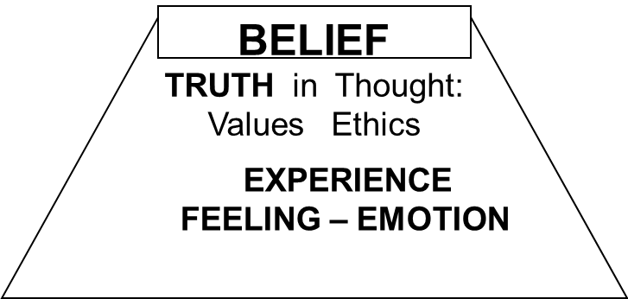
Belief is distinct from truth

Slide 34
Charge #1 is to obey truth not belief
Charge #2 is to practice truth not belief
Know truth
Translate truth into transferable beliefs

Slide 35
BOLD IN YOUR BELIEFS
TRUTH is what it is. Belief is what you turn it into

