Slide 1
“that you may know the certainty” (Luke 1:4)

Slide 2
THE GOSPEL ACCORDING TO LUKE

Slide 3
THE GOSPEL
1Corinthians 15:1-8

Slide 4
THE GOSPEL ACCORDING TO LUKE
Luke 23:50-24:49

Slide 5
CHRIST DIED
23:46-49
Luke’s narrative

Slide 6
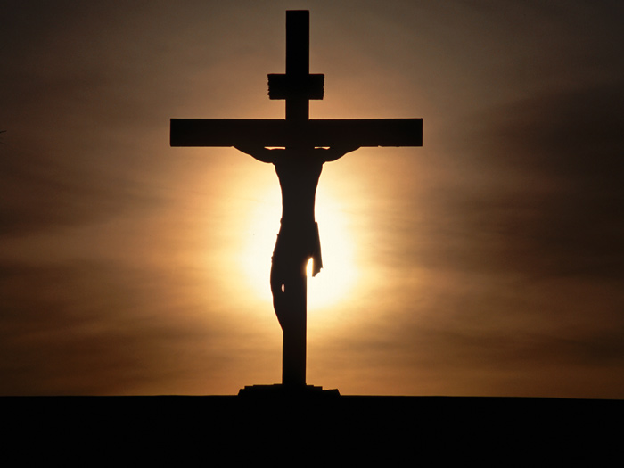

Slide 7
CHRIST DIED
23:46-49
Luke’s narrative
Eyewitnesses of Christ’s death
--centurion
--crowd
--acquaintances and women from Galilee
--others mentioned earlier
**Significance—Christ died FOR OUR SINS

Slide 8
CHRIST WAS BURIED
23:50-56
Luke’s narrative

Slide 9
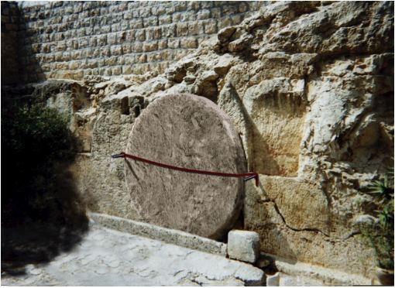

Slide 10
CHRIST WAS BURIED
23:50-56
Luke’s narrative
Eyewitnesses of Christ’s burial
--Joseph of Arimathea (and Nicodemus)
--Women from Galilee
**Significance—Christ was truly dead (died for us)

Slide 11
CHRIST ROSE AGAIN THE 3RD DAY
24:1-12
Luke’s narrative

Slide 12
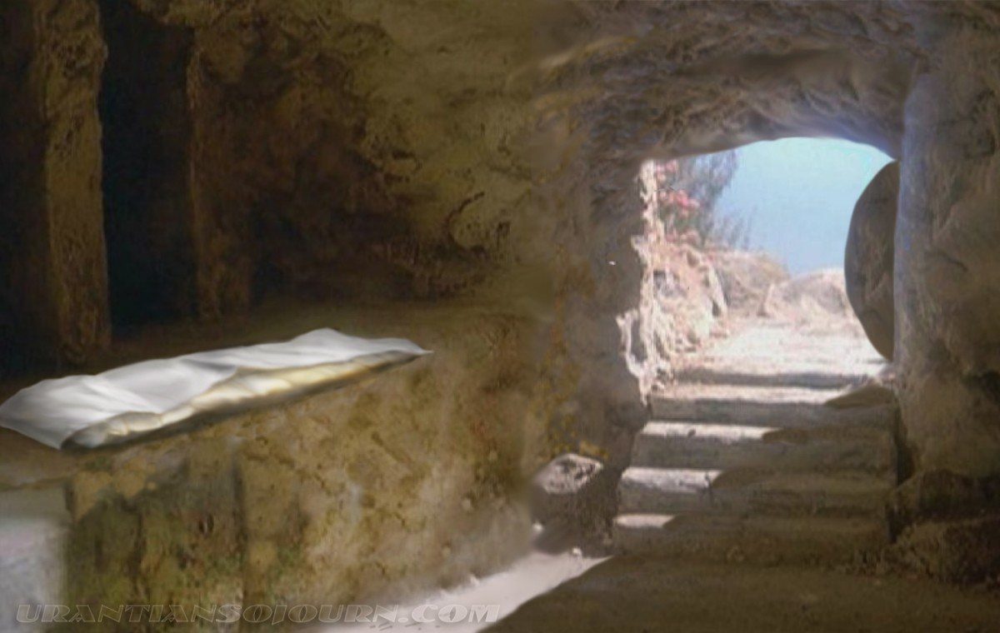

Slide 13
CHRIST ROSE AGAIN THE 3RD DAY
24:1-12
Luke’s narrative
Eyewitnesses of Christ’s empty tomb
--women
--Peter (and John)
**Significance—

Slide 14
Significance of His Resurrection
Proof of His Word (fulfilled prophecy)
--Matthew 12:40 (example of Jonah)
Proof of His identity (Son of God)
--Romans 1:4
Proof of the sufficiency of His payment for sin
--Romans 4:24-25

Slide 15
CHRIST ROSE AGAIN THE 3RD DAY
24:1-12
Luke’s narrative
Eyewitnesses of Christ’s empty tomb
--women
--Peter (and John)
**Significance—proof of Word, identity, sufficiency

Slide 16
CHRIST WAS SEEN
24:13-49
Luke’s narrative

Slide 17
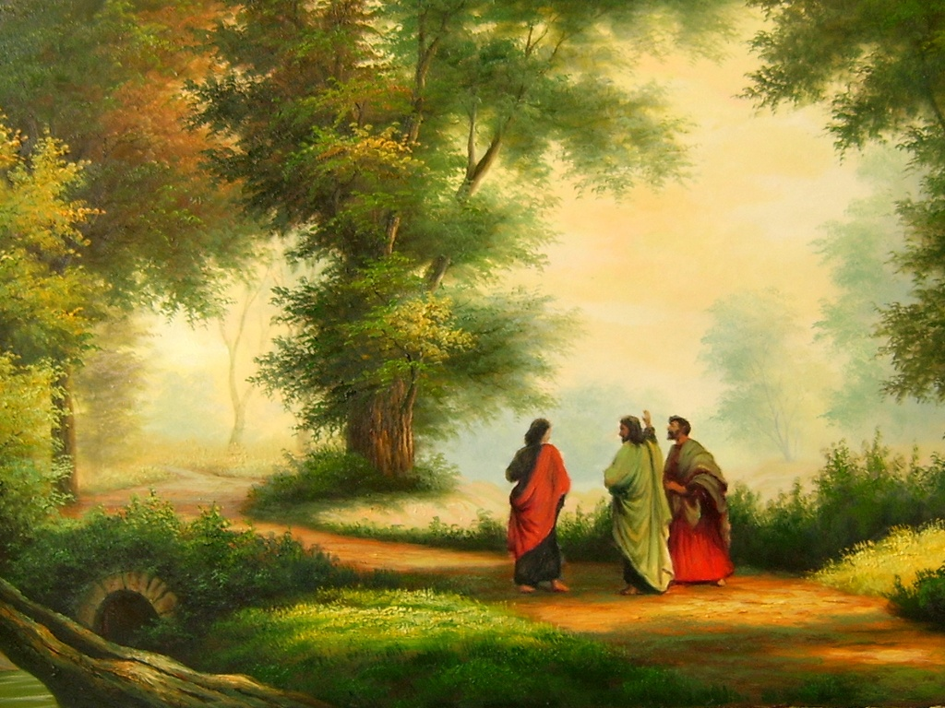

Slide 18
CHRIST WAS SEEN
24:13-49
Luke’s narrative
Eyewitnesses of Christ’s appearance after resurrection
--2 disciples on the road to Emmaus
--Peter
--11 disciples plus others
--(other appearances not recorded by Luke)
**Significance—proves He has risen from the dead for us

Slide 19
YOUR PROVISION FOR LIVING OUT THE GOSPEL
COMPREHENSION—of the Scriptures (24:45-46)
COMMISSION—as a witness (24:47-48)
CLOTHING—the Holy Spirit’s power (24:49)

Slide 20
WHAT WILL YOU DO WITH THE GOSPEL???

