Slide 1
πολυτελης poluteles pol-oo-tel-ace

Slide 2
DECIDING WOMEN

Slide 3
MOST MEMORABLE
Mark 14:3
Mark presents it through a PURE SACRIFICE
Highly valued ointment of spikenard
Pure

Slide 4
Clive Christian Perfume: $215,000 for 16.90 ounces ($12,722/oz.)

Slide 5
MOST MEMORABLE
Mark 14:3
Highly valued ointment of spikenard
Pure
Broke the flask and poured it on His head as a pure offering

Slide 6
MOST MEMORABLE
a pure sacrifice that others criticized
a pure good work that others misunderstood
a pure deed that others misunderstood
a pure insight that others missed

Slide 7
MOST MEMORABLE
Mark 14:3
Mark presents it through a PURE SACRIFICE
Highly valued ointment of spikenard
Pure
Broke the flask and poured it on His head as a pure offering
**what possession do you highly value that could be sacrificed in pure appreciation to the Lord?

Slide 8
MOST ATTRACTIVE
1Timothy 2:9
Paul presents it through a POOR SUBSTITUTE
Highly valued clothing

Slide 9
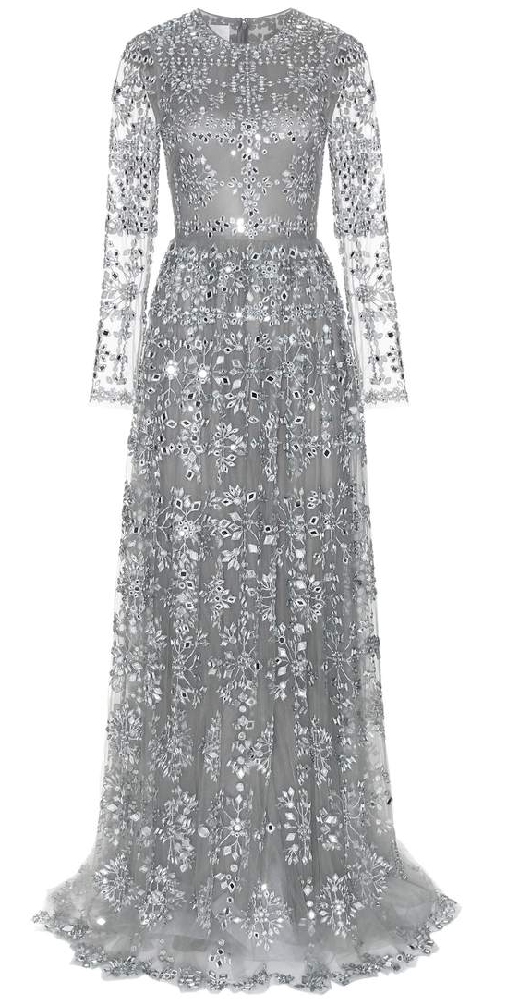
Valentino Embellished tulle gown $ 28,000 incl. duties, handling excl. shipping costs

Slide 10
MOST ATTRACTIVE
1Timothy 2:9
Paul presents it through a POOR SUBSTITUTE
Highly valued clothing
Poor
Professing godliness
Good works
**What are valuing more highly than your profession of godliness through good works?

Slide 11
MOST INFLUENTIAL
1Peter 3:4
Peter presents it through a PAR SUBMISSION
Highly valued gentle and quiet spirit
Par
Submission by faith

Slide 12
How do you develop this spirit?
Word of Christ dwelling in you as you take It in by faith
Spirit of Christ living through you as you walk in Him by faith
Life of Christ living through you as you yield to Him by faith

Slide 13
MOST INFLUENTIAL
1Peter 3:4
Highly valued gentle and quiet spirit
Par
Submission by faith
**Does what you are truly valuing reveal the condition of your faith in God?

Slide 14
DECIDING WOMEN
Most Memorable
Most Attractive
Most Influential
A pure sacrifice
A poor substitute
A par submission

Slide 15
It’s YOUR decision...

