Slide 1
HAGGAI & ZECHARIAH

Slide 2
TO BABYLON AND BACK
Southern tribes (Judah) exiled to Babylon in 605 (Daniel)/597 (Ezekiel)/586 (temple destroyed) BC
Southern remnant returned to Judah 538 (Zerubbabel)/458(Ezra)/445 (Nehemiah) BC

Slide 3
CHRONOLOGY OF HAGGAI & ZECHARIAH
539 BC Persia conquers Babylon
538 BC Temple construction decreed by Cyrus (Ezra 1)
Return under Zerubbabel (Ezra 2)
536 BC Temple construction begins (Ezra 3)
534 BC Temple construction halted (Ezra 4)
520 BC Haggai’s ministry to returned remnant (Ezra 5)
Temple construction resumes (Ezra 6)
516 BC Temple construction completed (Ezra 6)

Slide 4
The Word of God is profitable for:
DOCTRINE—what is right
REPROOF—what is not right
CORRECTION—how to get right
INSTRUCTION IN RIGHTEOUSNESS—how to stay right

Slide 6
The Prophet’s Profit for Reproof
1:1-15 PRIORITY (6/1/2)
Reproof = conviction through evidence presented
Evidence presented—their own words, temple condition, their ways, the LORD’s Presence
Evidence presented reproved the remnant for their failed priority
Does evidence reprove us for failed priority?

Slide 7
The Prophet’s Profit for Correction
2:1-9 GLORY 7/21/2
Correction = restoration to a right state
Wrong thinking (regarding the temple)
Application to your body and Body of Christ

Slide 8
The Prophet’s Profit for Instruction in Righteousness
2:10-19 PURITY
9/24
Instruction in righteousness = training in right living
Questioning of priests regarding purity
Purity of life requires repentance

Slide 9
The Prophet’s Profit for Doctrine
2:20-23 AUTHORITY
9/24
Doctrine = teaching
Teaching regarding God’s plans
--for the Gentile nations
--for Israel

Slide 10
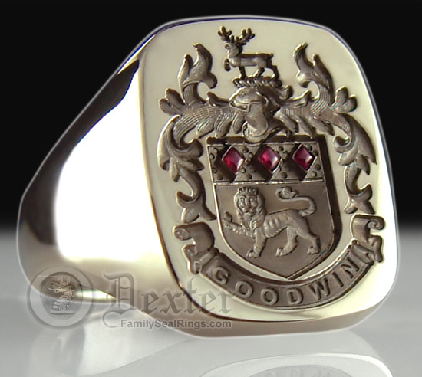

Slide 11
The Prophet’s Profit for Doctrine
2:20-23
Doctrine = teaching
9/24
Teaching regarding God’s plans
--for the Gentile nations
--for Israel—authority
--for us

Slide 12
Some trust in chariots, and some in horses; but we will remember the Name of the LORD our God. (Psalm 20:7)

Slide 13
Haggai
Name means “festal”…”pertaining to festivals
Joyful celebration
Be involved in edification, regardless of the conditions without or within
The Word of the Lord came by Haggai the prophet…and other prophets and apostles…to YOU!
Rejoice!

