Slide 1
WHO IS HE?

Slide 2
And beginning at Moses and all the Prophets, He expounded to them in all the Scriptures the things concerning Himself. (Luke 24:27)

Slide 3
SEEING JESUS IN JUDGES

Slide 4
CYCLE IN JUDGES
Israel forsakes God God judges Israel
Israel enjoys freedom Israel suffers
God provides deliverance Israel cries to God

Slide 5
SEEING JESUS IN JUDGES
SAMSON
Judges 13-16

Slide 6
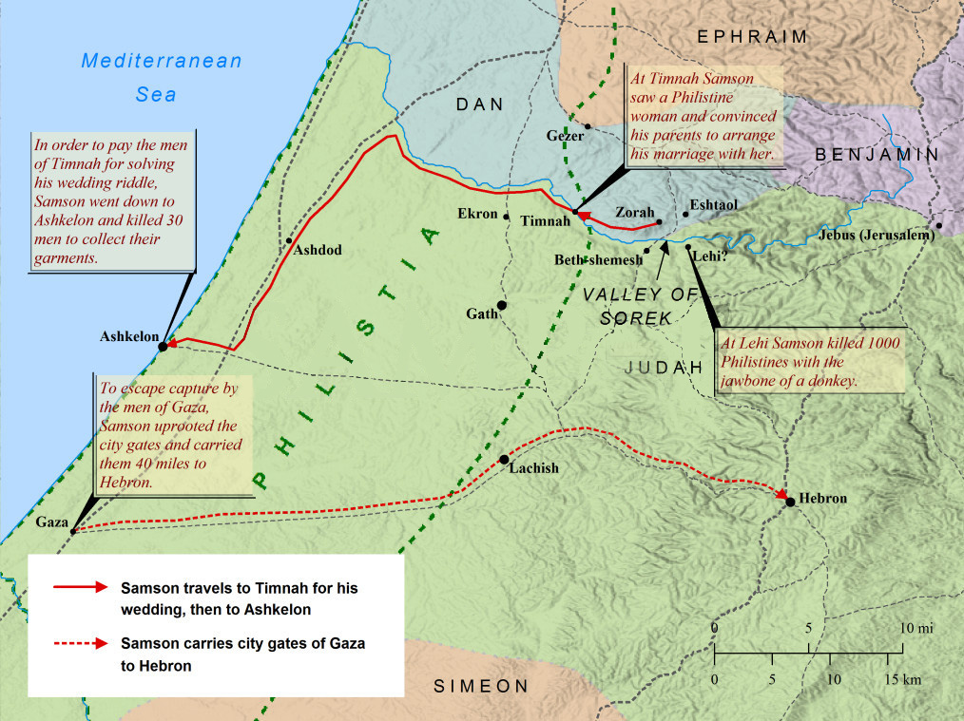

Slide 7
The Holy Spirit Initiated Their Earthly Ministries
Samson (13:1-25)
“And the Spirit of the LORD began to move upon him” (13:24-25)
Jesus
--His conception (Luke 1:35; Matt.1:18-20)
--His baptism (Matt.3:16; John 1:32; Luke 3:22)

Slide 8
The Holy Spirit Guided Their Earthly Ministries
Samson (14:1-6)
--“it was of the LORD” (14:4)
--“the Spirit of the LORD came upon him mightily” (14:6)
Jesus
--Temptation in the wilderness (Lk 4:1-2; 1Pe 5:8)

Slide 9
The Holy Spirit Empowered Their Earthly Ministries
Samson (14:7-20)
--riddle debt payment
Jesus
--His ministry activities --Isa.11; Mt.12; Isa.61; John 3; Luke 4; Acts 1,10
--Judging, declaring justice, preaching, healing, proclaiming, teaching, commanding, doing good

Slide 10
The Holy Spirit Accomplished Their Earthly Ministries
Samson (14:20-15:20)
--tails and torches
--”the Spirit of the LORD came mightily upon him” (15:14)
--donkey’s jawbone

Slide 11
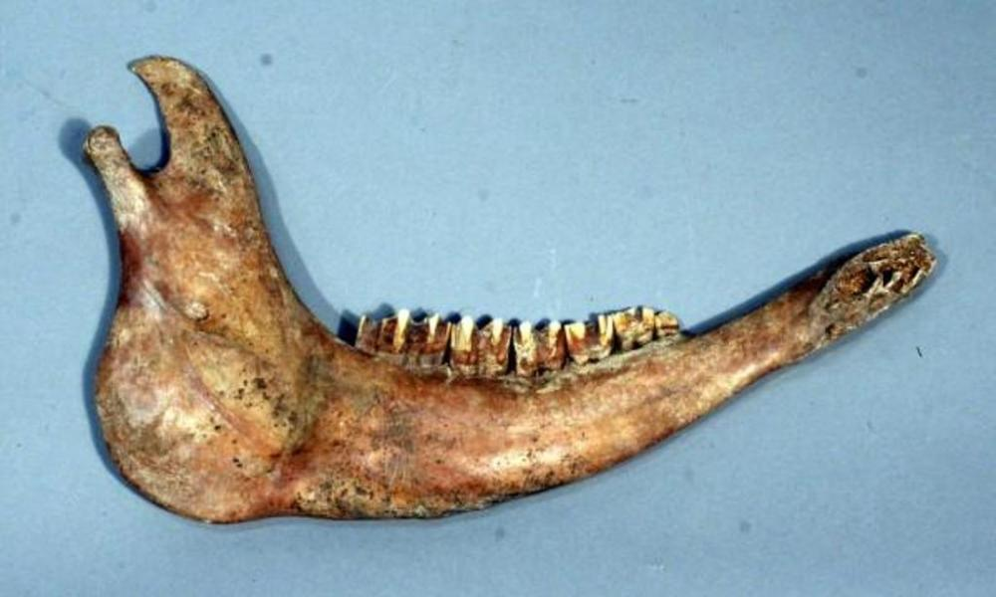

Slide 12
The Holy Spirit Accomplished Their Earthly Ministries
Samson (14:20-15:20)
--tails and torches
--”the Spirit of the LORD came mightily upon him” (15:14)
--donkey’s jawbone
Jesus
--Hebrews 9:14 conscience cleansing

Slide 13
Take-Aways
The Holy Spirit initiates your earthly ministry --John 3:6-8; Galatians 3:3
The Holy Spirit guides your earthly ministry --Romans 8:14; Galatians 5:18
The Holy Spirit empowers your earthly ministry --1Corinthians 12:7,11
The Holy Spirit accomplishes your earthly ministry --John 14:26; 16:7-14

