Slide 1
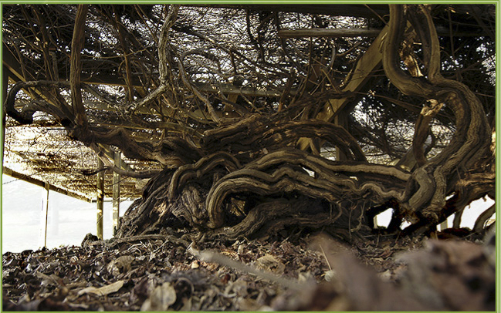

Slide 2
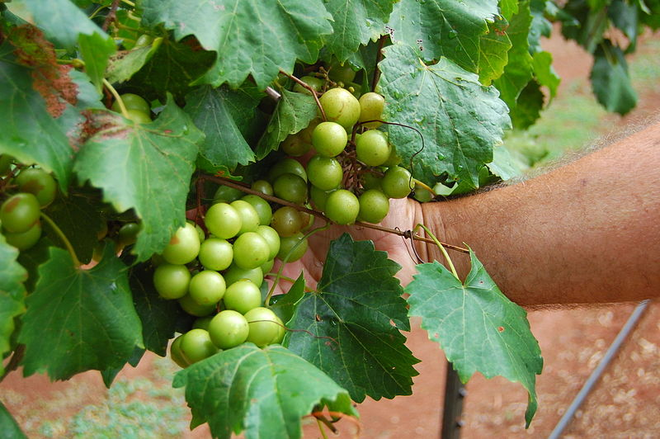

Slide 3
Are you abiding in the true vine?
John 15:1-11

Slide 4
Are you abiding in the Vine?
What does it mean to abide in the Vine?

Slide 5
What does it mean to abide in the Vine?
Picture
1. Vine—Christ
2. Farmer—God the Father
3. Branches—believers
4. Abide—remain, continue, dwell

Slide 6
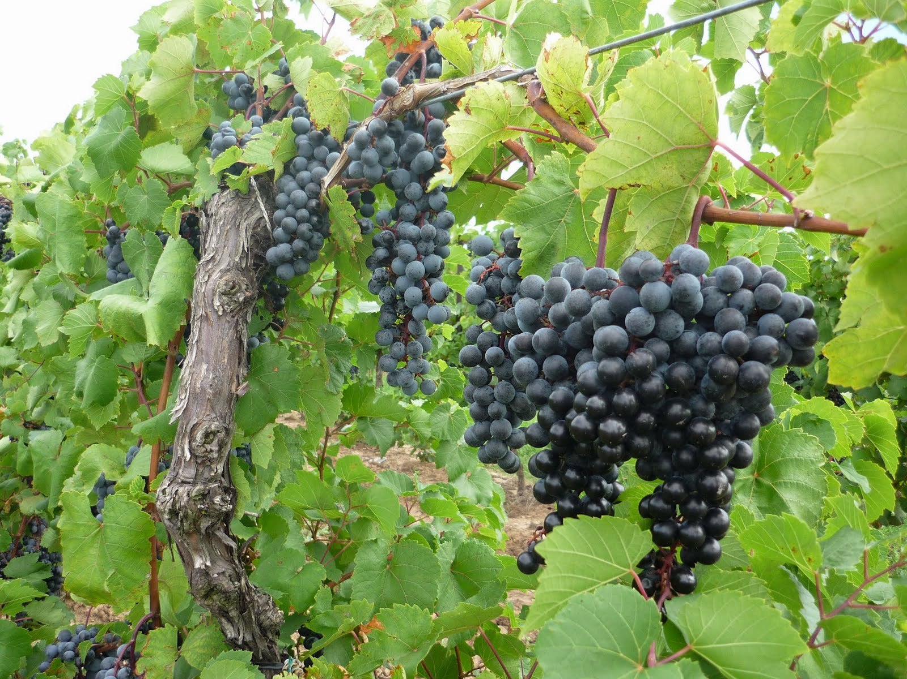

Slide 7
What does it mean to abide in the Vine?
Picture
1. Vine—Christ
2. Farmer—God the Father
3. Branches—believers
4. Abide—remain, continue, dwell
Position and Practice
1. Position—possessing a connection with Christ
2. Practice—practicing a connection with Christ

Slide 8
What does it mean to abide in the Vine?
Do you personally possess a positional connection with the True Vine by grace through faith?
On a scale of 1 (low) to 10 (high), what is your honest evaluation of your practical connection with the True Vine?

Slide 9
Are you abiding in the Vine?
What does is mean to abide in the Vine?
What should motivate me to abide in the Vine?

Slide 10
What should motivate me?
OPPORTUNITY for…
Productivity to be reality (v.2,4,5,6,8)
Prayer to be answered (v.7)

