Slide 1
HAPPY 2018

Slide 4
Get Outside in 2018
“those who are outside”
Colossians 4:4-5
1Thessalonians 4:12
1Timothy 3:7
1Corinthians 5:12
Challenging for those who are inside… ”in Christ: (Phi.1:1); “in the body” (1Cor.12:18); “in the church” (1Cor.12:28); “in the faith” (2Co.12:5)

Slide 5
Getting outside is uncomfortable

Slide 6
Getting outside is dangerous

Slide 7
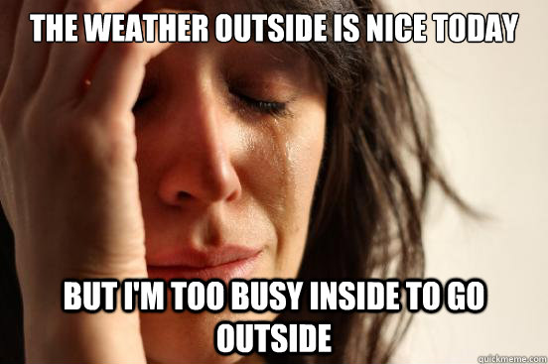
Getting outside is inconvenient

Slide 8
We need motivation to get outside

Slide 9
Get outside
because it’s better inside

Slide 10
because it’s better inside
Contradictory???
Better inside…
--no condemnation (Rom.8:1)
--Christ as our wisdom… (1Cor.1:30)
--new life (2Cor.5:17)
--liberty (Gal.2:4)
--unity (Gal.3:28)
**Do you want others to experience the better?

Slide 12
Get outside
because it’s better inside
because it’s expected of those inside

Slide 13
because it’s expected of those inside
Whose expectations are you seeking to live up to?
God expects those who are inside to go to those who are outside
“And He said to them, ‘Go into all the world and preach the gospel to every creature.’” (Mark 16:15)
“Go therefore and make disciples of all the nations…” (Matthew 28:19)
**Will you, by God’s grace, seek to live up to HIS expectations rather than your own?

Slide 15
Get outside
because it’s better inside
because it’s expected of those inside
because it’s healthy for those inside

Slide 16
because it’s healthy for those inside
Getting outside to walk wisely (Col.4:5) and properly (1Thess.4:12) is good for your spiritual health
--your personal spiritual health
--the spiritual health of the Body of Christ
**Are you willing to suffer pain for gain?

Slide 18
Get outside
because it’s better inside
because it’s expected of those inside
because it’s healthy for those inside
because it’s essential for those outside

Slide 19
because it’s essential for those outside
So that they can see us
--walking in wisdom and properly toward them
--not judging them (2Cor.5:12)
--having a good testimony among them (1Tim.3:7)
So that they can ask for answers to their questions
So that they can hear our gracious words (Col.4:6)
--conversation, concern, Christ
So that they have time…take the opportunity (4:5)
**Will you take what may be their (or your) last opportunity?

Slide 20
Get outside
because it’s better inside
because it’s expected of those inside
because it’s healthy for those inside
because it’s essential for those outside

Slide 21
Let’s do this together in 2018, for the glory of God!

