Slide 1
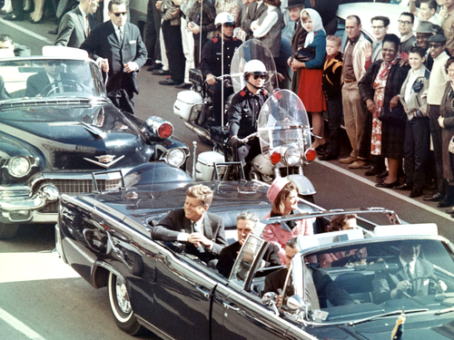
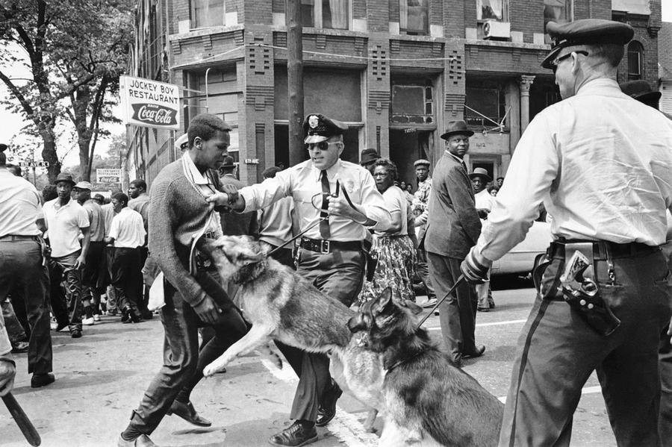
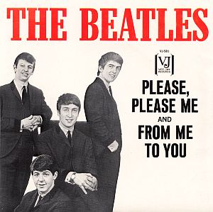
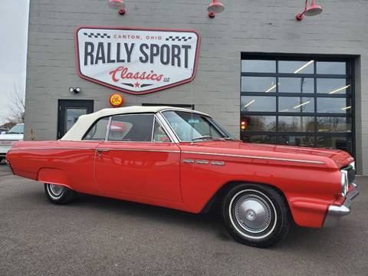
1 9 6 3

Slide 2
57 AD
Approximate year of the writing of Paul’s “second” letter to the Corinthians

Slide 3
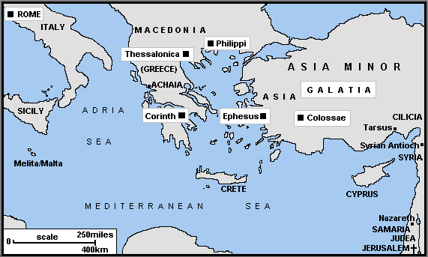

Slide 4
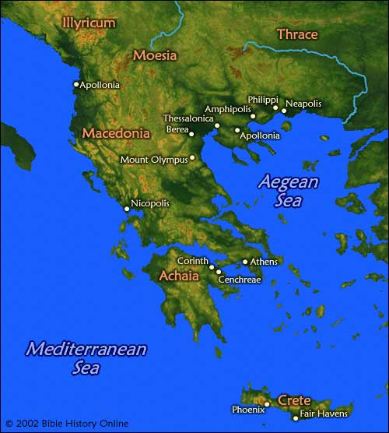

Slide 5
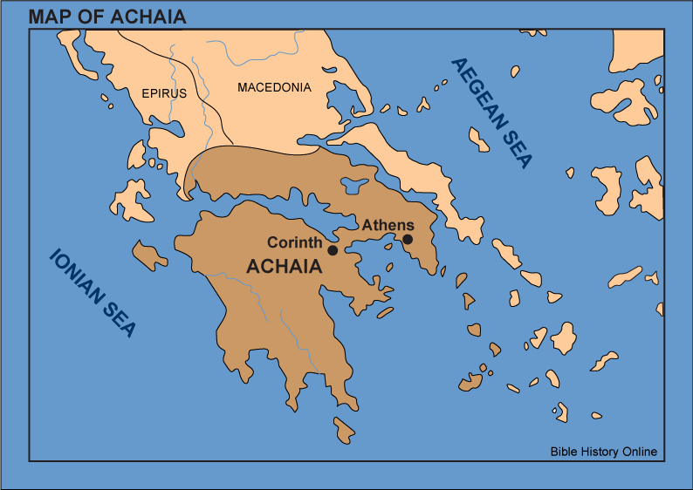

Slide 6
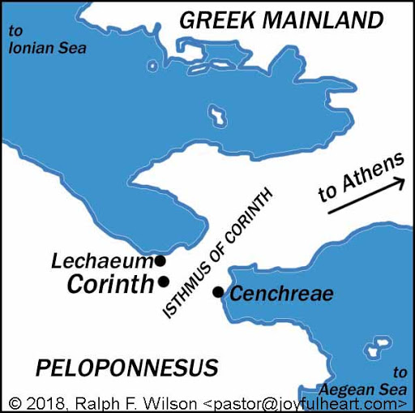

Slide 7
2 Corinthians
Paul’s defense of his apostleship, which was being questioned by critics and false teachers in Corinth
--His care was being questioned (ch.1-7)
--His counsel was being neglected (ch.8-9)
--His credibility was being undermined (ch.10-13)
4 key elements of Paul’s introduction

Slide 9
MESSENGER
An Introduction to Paul’s 2nd recorded letter to the church at Corinth
2 Corinthians 1:1-2

Slide 10
A MODEL MESSENGER
PAUL—an apostle
--“apostle” = one who is sent; a messenger
*primary sense—personal commission by the risen Lord
*secondary sense—sent by Lord or local church
--”of Jesus Christ” = authority & accountability
--”by the will of God” = in accordance with God’s plan
--importance for Paul & his ministry: defense of his ministry
--importance for you & your ministry (Jn 13:16; 20:21; Rom 10:15)
--Paul as our model (1Cor.11:1)
**Ask the Lord to make you a messenger like Paul as he is like Christ

Slide 11
A FUNCTIONING FAMILY
TIMOTHY—our brother
--emphasis on family
--in what sense are true believers a family?
--how is the family of God to function?
*as family members
*as messengers

Slide 12
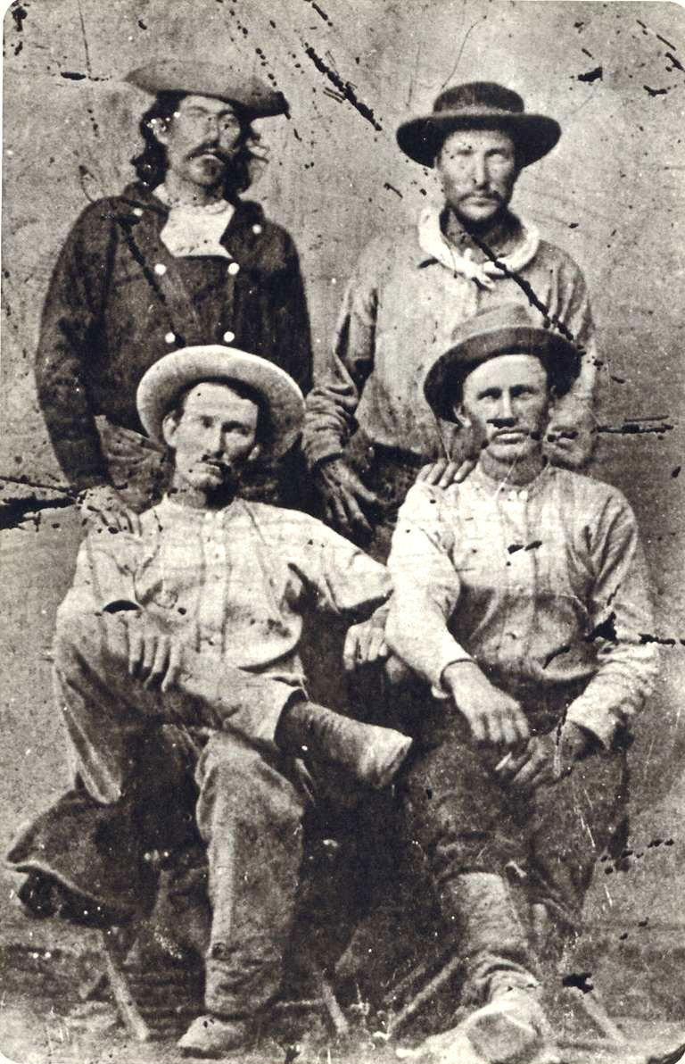
Charles Cliff and Gus Cliff (seated in picture) brothers who rode with the Pony Express

Slide 13
A FUNCTIONING FAMILY
TIMOTHY—our brother
--emphasis on family
--in what sense are true believers a family?
--how is the family of God to function?
*as family members
*as messengers
**Your family needs you to message with them…will you?

