Slide 1
PRAYER WORKS

Slide 2
Prayer DOES Work
“The effective, fervent prayer
of a righteous man
avails much.”
(James 5:16b)
Prayer accomplishes an abundance!

Slide 3
Prayer IS Work
“Prayer does not fit us for greater works; prayer is the greater work.” –Oswald Chambers

Slide 4
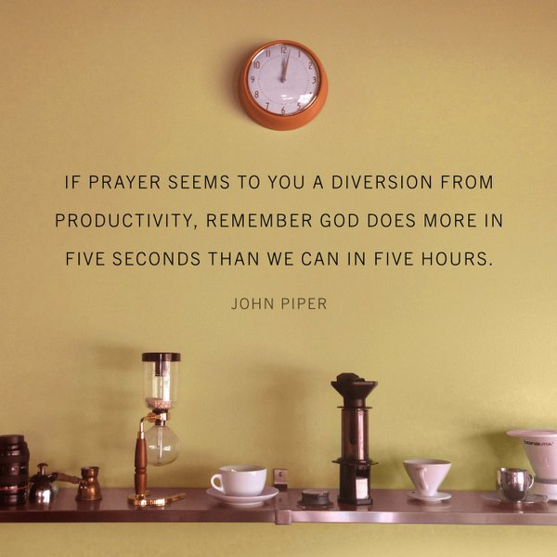

Slide 5
HISTORY of “Prayer is Work”
Prayer was work in the Old Testament period
Prayer was work in the New Testament period
Prayer has been work during the church period
Prayer is work in the church today
Prayer is work in our church today
**What is YOUR prayer history?
**Do YOU work in prayer?

Slide 6
MYSTERY of “Prayer is Work”
Reconciling…
1. Work and faith
2. Work and rest
3. Work and grace
4. Work and fellowship

Slide 7
MYSTERY of “Prayer is Work”
“Pray as though everything depended on God; work as though everything depended on you”
**Work in prayer as though everything depended on you praying and as though everything depended on God answering

Slide 8
MASTERY of “Prayer is Work”
Boldly appealing to the character of God

Slide 9
Boldly appealing to character of God
(Gen 18:23-32)
Abraham

Slide 10
MASTERY of “Prayer is Work”
Boldly appealing to the character of God
Tenaciously requesting the blessing of God

Slide 11
Tenaciously requesting the blessing of God
Genesis 32:24-30
Jacob

Slide 12
MASTERY of “Prayer is Work”
Boldly appealing to the character of God
Tenaciously requesting the blessing of God
Humbly pleading for the action of God

Slide 13
Humbly pleading for the action of God
Daniel 9:3,5,19
Daniel

Slide 14
MASTERY of “Prayer is Work”
Boldly appealing to the character of God
Tenaciously requesting the blessing of God
Humbly pleading for the action of God
Actively identifying with the need before God

Slide 15
Actively identifying with the need before God
1Kings 17:21
Elijah

Slide 16
MASTERY of “Prayer is Work”
Boldly appealing to the character of God
Tenaciously requesting the blessing of God
Humbly pleading for the action of God
Actively identifying with the need before God
Emotionally seeking the mercy of God

Slide 17
Emotionally seeking the mercy of God
Ezra 9:5-6,15; 10:1
Ezra

