Slide 2
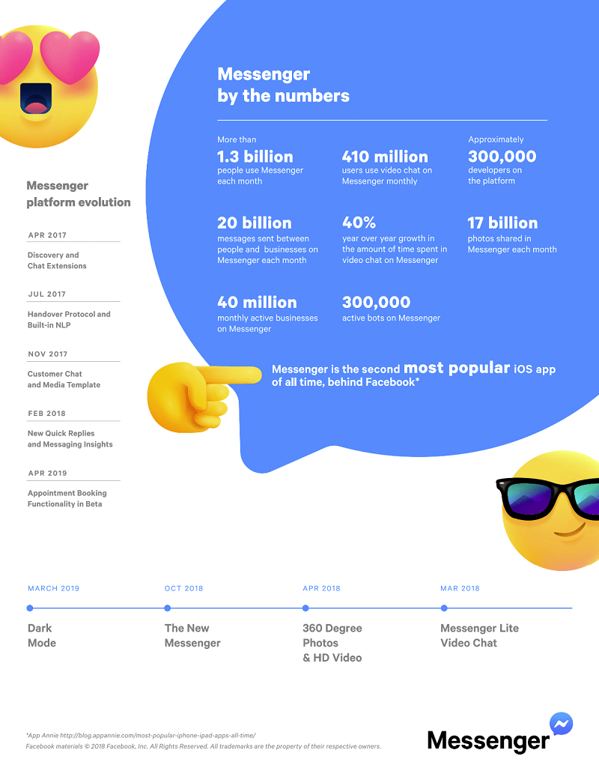

Slide 3
MESSENGER
An Introduction to Paul’s 2nd recorded letter to the church at Corinth
2 Corinthians 1:1-2

Slide 4
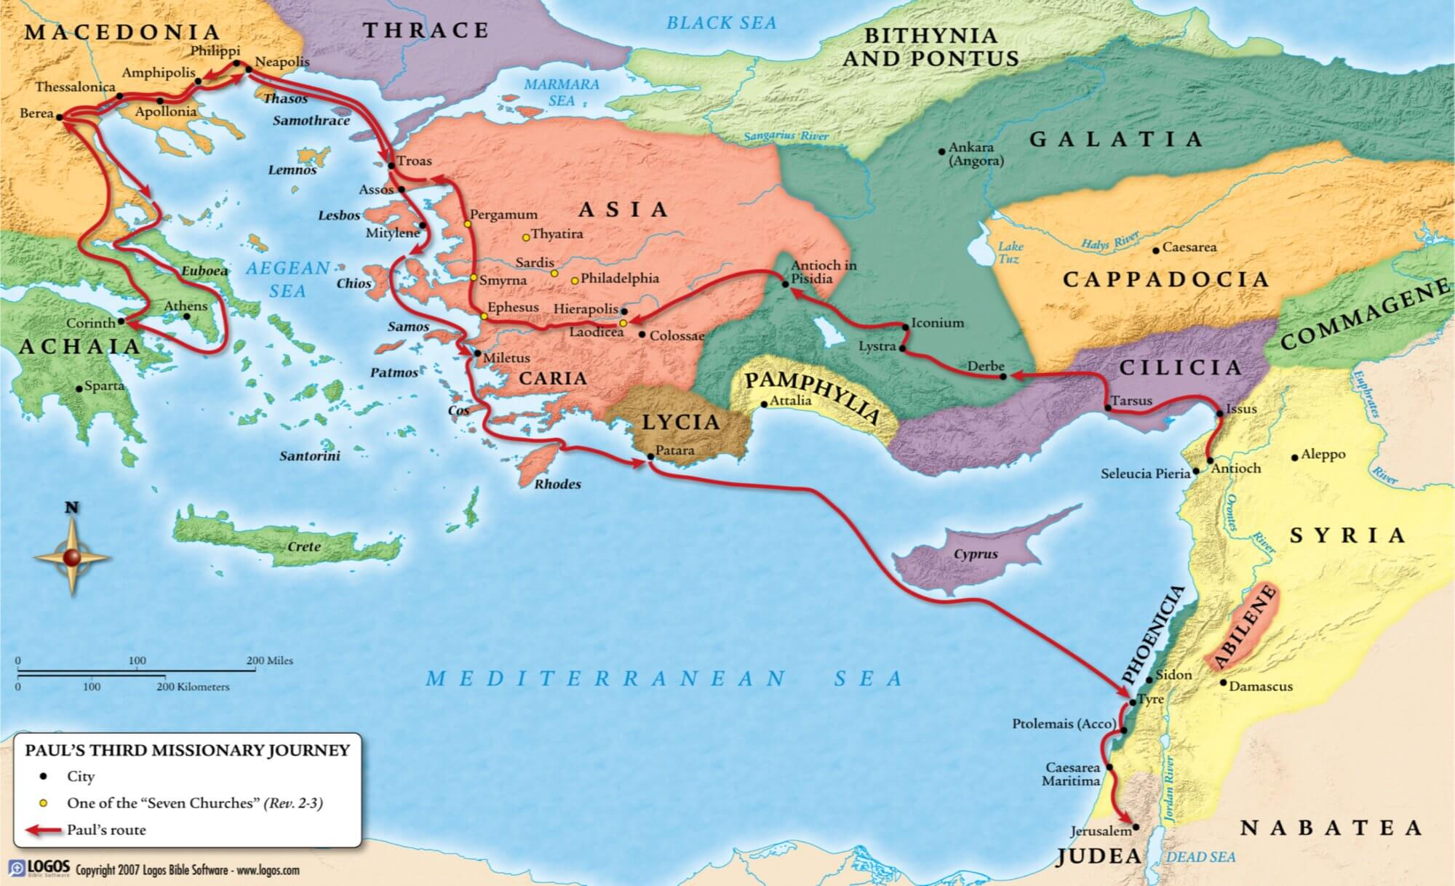

Slide 5
A MODEL MESSENGER
PAUL—an apostle (one who is sent; a messenger)
*primary sense—personal commission by risen Lord
*secondary sense—sent by the Lord or local church
--”of Jesus Christ” = authority & accountability
--”by the will of God” = in accordance with God’s plan
--importance for Paul: defense of his ministry
--importance for you: Paul as our model (1Cor.11:1)

Slide 6
A FUNCTIONING FAMILY
TIMOTHY—our brother
--emphasis on family
--how is the family of God to function?
*as family members
*as messengers

Slide 7
A RECOGNIZED RECIPIENT
“the church…the saints”
THE CHURCH
--ekklesia = ones who are called out (by God)
*of the world, to God, with one another
*universal and local
*application to us

Slide 8
A RECOGNIZED RECIPIENT
“the church…the saints”
THE SAINTS
--hagios = ones who are set apart (by God)
*from sin, to God, with all saints
*in ALL Achaia
*application to us

Slide 9
A RECOGNIZED RECIPIENT
THE CHURCH
--ekklesia = ones who are called out
THE SAINTS
--hagios = ones who are set apart
**How does recognizing yourself and SHBC as ones who are “called out” and “set apart” impact your confidence as a messenger?

Slide 10
A SUPERNATURAL SOURCE
“God our Father and the Lord Jesus Christ”
--the Trinity (Triunity)
--”our Father”--emphasis on family (cp. “brother”)
--”the Lord”—emphasis on authority (cp. “apostle”)
--blessings flowing
*grace—unearned & undeserved
*peace—tranquility & well-being
**Will you commit to embrace, enjoy, express, and extend the blessings of grace & peace from God?

Slide 11
MESSENGER
A Model Messenger—Paul, an apostle
A Functioning Family—Timothy, our brother
A Recognized Recipient—the church…the saints
A Supernatural Source—God our Father and the Lord Jesus Christ
**God has equipped you to be a messenger of His Son, the Lord Jesus…will you take a step of faith now?

