Slide 1
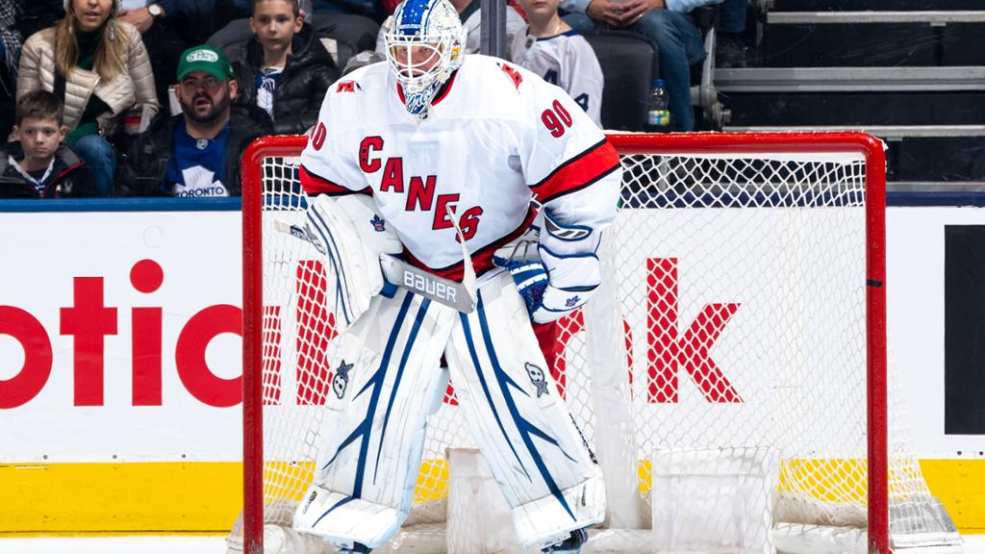
EBUG

Slide 2
messenger
A Study of 2 Corinthians

Slide 3
TRUSTWORTHY MESSENGERS
2Corinthians 1:12-22

Slide 4
TRUSTWORTHY MESSENGERS
Be gripped by the necessity of being viewed as trustworthy…otherwise the message you deliver will be suspect at best, and discounted at worst
Discuss 3 vital characteristics of trustworthy messengers

Slide 5
Trustworthy Messengers Do What They Should (v.12)
Focus of the self-evaluation
Means of the self-evaluation
Context of the self-evaluation
Results of the self-evaluation

Slide 6
Trustworthy Messengers Do What They Should (v.12)
Results of the self-evaluation
*Conduct that should be:
1. simple and sincere—not hypocritical
2. void of fleshly wisdom—not self-pleasing
3. by God’s grace—undeserved and unmerited

Slide 7
Trustworthy Messengers Do What They Should (v.12)
Focus of the self-evaluation
Means of the self-evaluation
Context of the self-evaluation
Results of the self-evaluation
Application of the self-evaluation
**Doing what you should motivates others to trust you as “real, by the grace of God”

Slide 8
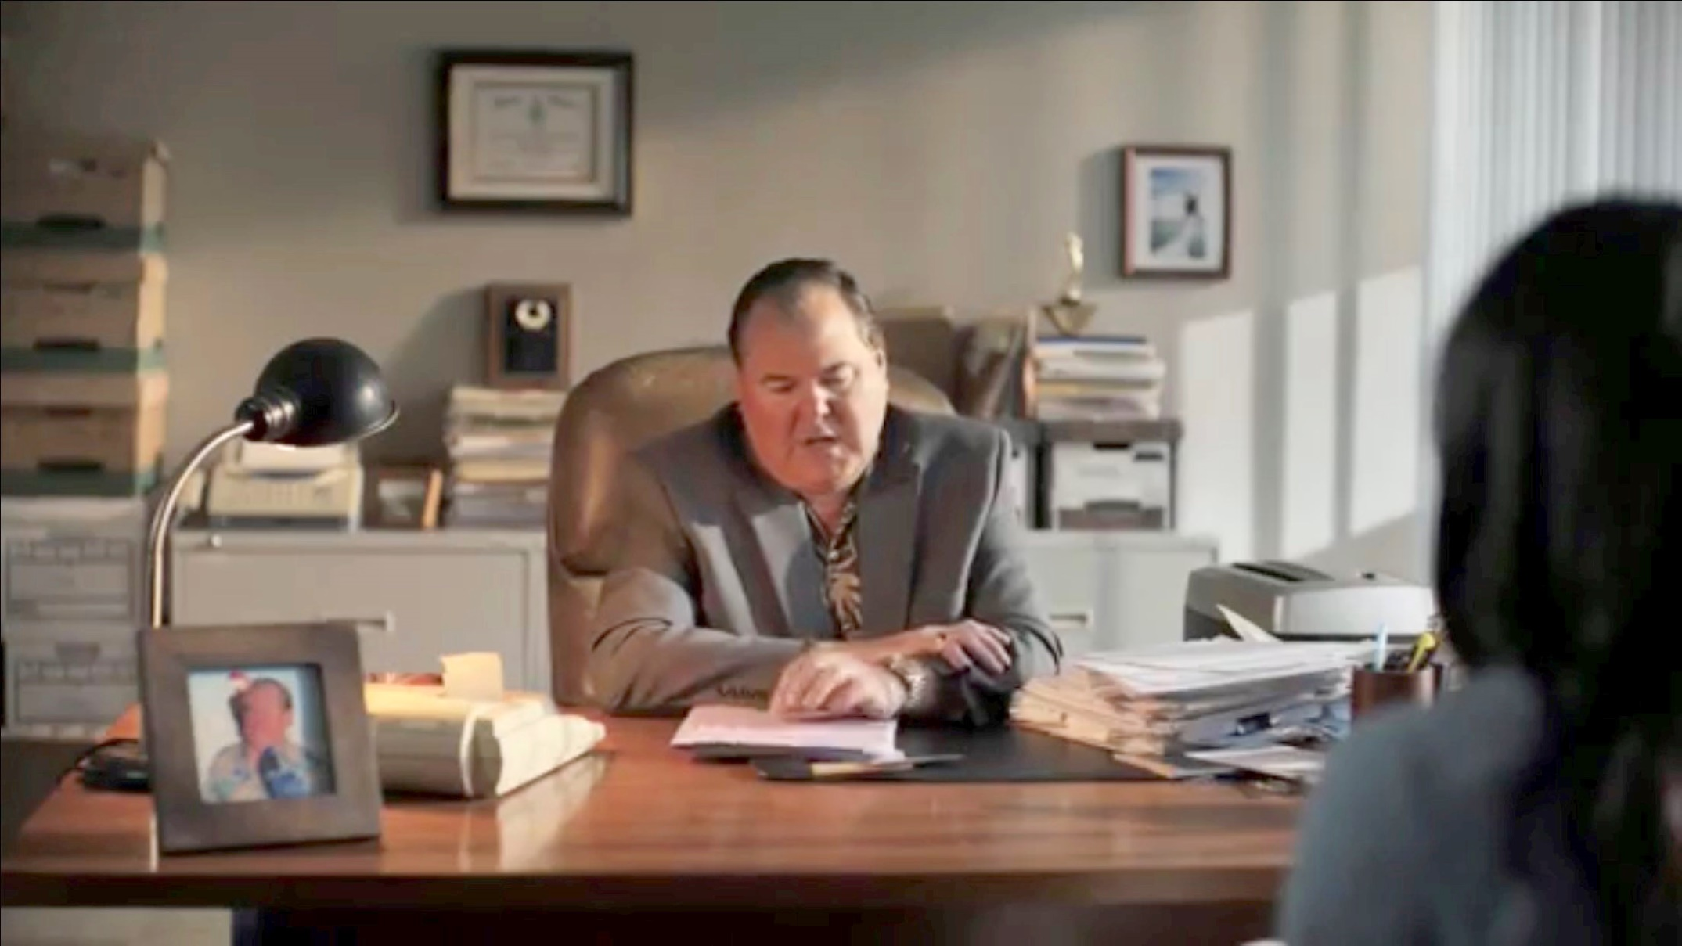
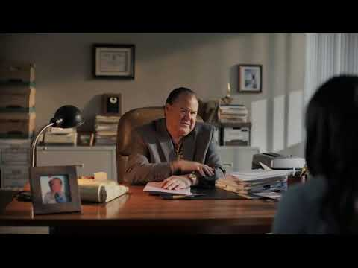

Slide 9
Trustworthy Messengers Say What They Mean (v.13-20)
Communication—written and/or spoken
Written—“writing” (v.13)…plain and clear

