Slide 2
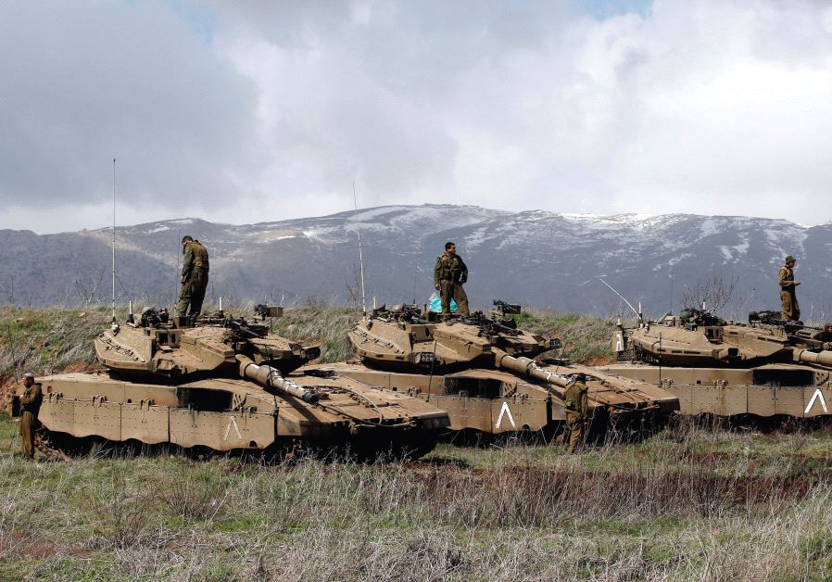
A 3-front war for Israel this year?

Slide 3
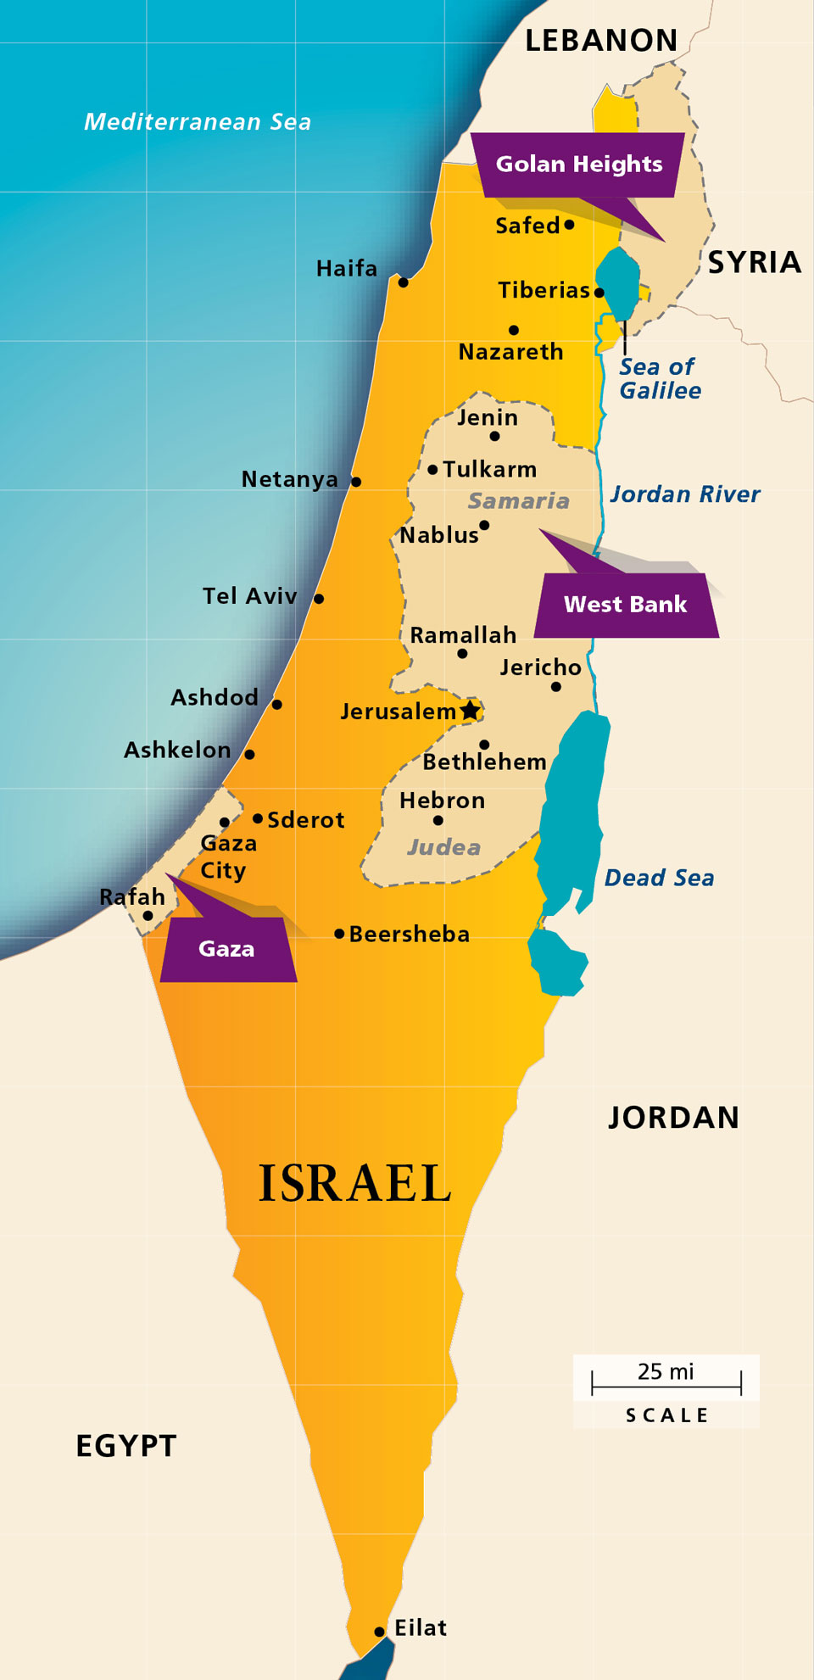

Slide 4
A 3-front war for the believer every day of every year
The World, The Flesh, & The Devil

Slide 5
What is the identity of this enemy?
2 Greek words
**kosmos = orderly arrangement (i.e., system)
**aion = age (i.e., the world system at a specific time period)
Both words have multiple meanings (context)
but they are closely related, and are often interpreted as referring to the system that is anti-God and an enemy of the believer
**Our enemy “the world” is the anti-God system of values that underlies the cultures of man

Slide 6
Why is the world considered an enemy of the believer?
It is dangerous to the believer’s well-being (Gal.1:4)
It is ruled by Satan (Jn.14:30; 1Jn.5:19)
It operates in coordination with the flesh (Eph.2:1-3)
Its principles are contrary to Christ (Col.2:8)
It hates and persecutes believers (Jn.15:18-19; Gal.6:12)
It stains and pollutes believers (Jam.1:27; 2Pe.2:20)
**These evidences of the world’s enmity against the believer should convince us to always take its threats seriously

Slide 7
What is the strategy of the world?
It fraternizes with the enemy (Jam.4:4; 1Jn.2:15; 2Ti.4:10)
It emphasizes the short-run (Mt.4:8; 1Jn.2:16)
It distracts from Headquarters (Mt.13:22)
It pressures for conformity (Rom.12:2)
It impresses with wisdom (1Cor.2:6; 3:18)
It traps with the basics (Gal.4:3; Col.2:8,20)
**Seduction and deception underlie the strategy of the world, so we are foolish if we think we can toy with this enemy

Slide 8
What is Christ’s provision for fighting the world?
Exposes its attitude re believers (Jn.15:18-19; 1Jn.3:1)
Exalts the Word & the Lord of the Word (Mt.4:10)
Makes faith reasonable (Gal.2:20; 1Jn.5:4-5)
Transforms minds (Rom.12:2)
Makes world’s wisdom foolish (1Cor.2:6; 3:18)
Delivers from bondage (Gal.1:4; Col.2:20)
**The Lord Jesus Christ and His cross are the key to my victory over the powerful enemy of the world

Slide 9
World’s strategy
Christ’s provision
Fraternizes w/ enemy
Emphasizes short-run
Distracts from HQ
Pressures for conformity
Impresses with wisdom
Traps with basics
Exposes true attitude
Exalts Word & Lord
Makes faith reasonable
Transforms minds
Makes wisdom foolish
Delivers from bondage

Slide 10
In what specific ways is the world system attacking you?
Are you committed to fight back from the position of being convinced that the world is crucified to you and you are crucified to the world?

