Slide 1
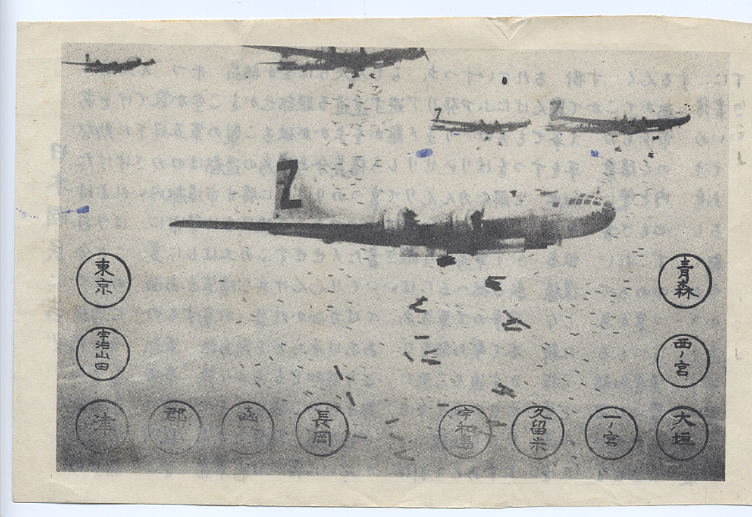

Slide 2
DESTRUCTION AHEAD
Luke 21:5-36

Slide 3
Preparation for destruction requires you to be
careful and prayerful

Slide 4
Preparation for the Destruction
Be careful (v.34-35)
**Beware the gradual addition of unhealthy weight (distractions)

Slide 5
Preparation for the Destruction
Be prayerful (v.36)
--true prayer is evidence of faith (Hebrews 11:6)
--Worthy…
**to escape
**to stand

Slide 6
Preparation for the Destruction
Worthy to escape
--the wrath to come (Luke 3:7)
--the judgment of God (Romans 2:3)
--the condemnation of hell (Matthew 23:33)
--the loss of reward (Revelation 3:11; 1Cor.3:15)
**by not neglecting “so great salvation” (Hebrews 2:3)

Slide 7
Preparation for the Destruction
Worthy to STAND based on:
--Grace (Romans 5:2)
--Faith (Romans 11:20)
--the Gospel (1Corinthians 15:1)
--God (Romans 14:4)

Slide 8
Preparation for the Destruction
WATCH
**We don’t watch TO be worthy to escape and stand, but we should watch BECAUSE:
--we have been made worthy to escape and stand
or
--we have not been made worthy to escape and stand

Slide 9
HOW WILL THE RECOGNITION OF “DESTRUCTION AHEAD” AFFECT YOUR DECISIONS TODAY?

Slide 10
IN WHAT SENSE DO YOU NEED TO BE CAREFUL TODAY? TO BE PRAYERFUL TODAY?

