Slide 1
WATCH YOUR MOUTH TOO
Proverbs about how we use our audible, verbal communication

Slide 2
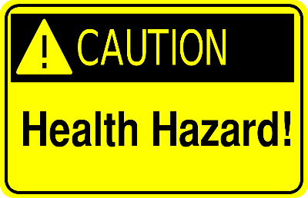
WATCH YOUR MOUTH TOO

Slide 3
TALK THAT IS TOO MUCH
Quantity should be evaluated
10:19 “multitude of words”—sin isn’t lacking
29:11 “vents all”—foolish
Potential damage to testimony &/or reputation
Antidote—listen more, before and for

Slide 4
TALK THAT IS TOO LOUD
Volume should be considered
27:14—it may have the reverse effect from what is intended
Potential negative impact on relationships
Antidote—be sensitive to the situation

Slide 5
TALK THAT IS TOO QUIET
Again, volume should be considered…
--and the motivation for the volume level!
16:28 “a whisperer”
25:23 “backbiting” (emphasis on secrecy)
Results in division, contention, conflict
Antidote—choose to talk to, not about, the person

Slide 6
TALK THAT IS TOO QUICK
“haste makes waste” and “speed kills”
18:13 answering before hearing
29:20 hasty in words
Potential folly, shame, self-destruction
--effect on testimony, respect, relationships
Antidote—slow down and take time to insure accuracy

Slide 7
TALK THAT IS TOO SELFIE
“death by selfie”
Is my talk too selfie?
27:2 self-praise
27:1 self-confidence
20:14 self-boasting
Effect on relationships and testimony
Antidote—humility

Slide 8
TALK THAT IS TOO LOOSE
“loose lips sink ships”
13:3 wide open lips
17:9 repeating a matter
18:8 (26:22) talebearer’s tasty trifles
20:19 revealing secrets
Effect on relationships and reputation
Antidote—tighten control over your tongue

Slide 9
TALK THAT IS TOO STRONG
“strong” isn’t always good
There is more than one way to say something
15:1 soft vs. harsh
Effect on relationships—stirring up anger
Antidote—soften your speech in wisdom

Slide 10
BEWARE HEALTH HAZARDS OF TALK THAT IS…
TOO MUCH—listen more deeply
TOO LOUD—be sensitive to the situation
TOO QUIET—talk to, not about, that person
TOO QUICK—slow down
TOO SELFIE—humble yourself
TOO LOOSE—tighten control
TOO STRONG—soften a bit

