Slide 1
BOLD IN THE LAW

Slide 2
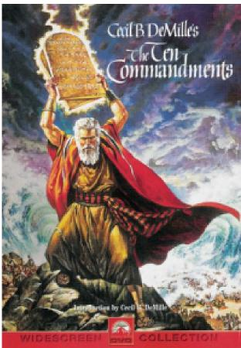

Slide 3
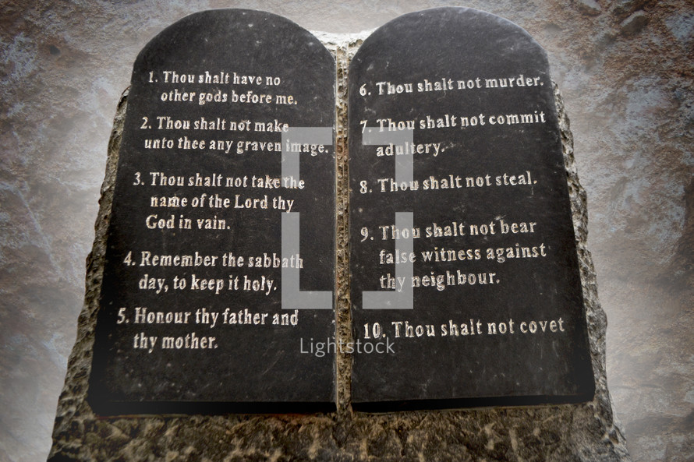
https://youtu.be/a8363Z3V0Es

Slide 4
Exo 20:12 NASB) "Honor your father and your mother
(Exo 20:13 NASB) "You shall not murder.
(Exo 20:14 NASB) "You shall not commit adultery.
(Exo 20:15 NASB) "You shall not steal.
(Exo 20:16 NASB) "You shall not bear false witness against your neighbor.
(Exo 20:17 NASB) "You shall not covet your neighbor's house; you shall not covet your neighbor's wife or his male servant or his female servant or his ox or his donkey or anything that belongs to your neighbor."
(Exo 20:3 NASB) "You shall have no other gods before Me.
(Exo 20:4 NASB) "You shall not make for yourself an idol,
(Exo 20:7 NASB) "You shall not take the name of the LORD your God in vain
(Exo 20:8 NASB) "Remember the Sabbath day, to keep it holy.
(Exo 20:11 NASB) "For in six days the LORD made the heavens and the earth, the sea and all that is in them, and rested on the seventh day; therefore the LORD blessed the Sabbath day and made it holy.
(

Slide 5
These are nothing new even in Ex 20
Moses is permanent fixture: Law of Moses Mal 4:4
Song of Moses Rev 15:3
No other God: Enoch and Noah walked with God only
Jacob to put away strange Gods (Gen 35:2)
Honor: Abraham Ishmael/Isaac Gen 25:9
Isaac Jacob/Esau Gen 25:9-10
Jacobs sons Gen 50:12-14
Murder: Cain Gen 3 and Lamech Gen 4
Adultery/ lie: Gen 12 Abraham and Pharaoh and Abimelech
Gen 20 Isaac and Abimelech
Steal : Joseph Benjamin Gen 44:4
Lie: Cain - don’t know where Able is
Covet: Eve
Sarah Ishmael
These are an expression of God’s holy character from the beginning

Slide 6
It Will Never Pass Away
The fact that God’s law expresses God’s character has many implications. One is that when we break God’s law we are making a direct assault on God himself. To worship another god is to deny God’s sovereignty; to misuse his name is to deny his honor; to steal is to deny his providence; to lie is to deny his truthfulness; and so forth. Every violation of the law is an offense against God’s holy character.
Another implication of the relationship between our Lord and his law is that the law is perpetually binding, that it remains in force for all persons in all places at all times. Sovereignty, justice, faithfulness, truthfulness, love—these are God’s eternal attributes. He would have to un-God himself to set them aside. We should expect, therefore, that the law that expresses his eternal attributes has eternal validity.
Ryken, P. G., & Hughes, R. K. (2005). (p. 528). Wheaton, IL: Crossway Books.
Ryken, P. G., & Hughes, R. K. (2005). Exodus: saved for God’s glory (p. 528). Wheaton, IL: Crossway Books.

Slide 7
The Goodness of Creation
Genesis 1 tells us over and over again an important thing about this creation. In 1:4 we read, “And God saw the light, that it was good.” The phrase that it was good is repeated in 1:10, 12, 18, 21 and 25. And 1:31 sums up the whole of God’s judgment: “And God saw everything that he had made, and, behold, it was very good.” This is not a relative judgment, but a judgment of the holy God who has a character and whose character is the law of the universe. His conclusion: “Every step and every sphere of creation, and the whole thing put together—man himself and his total environment, the heavens and the earth—conforms to Myself.”
Schaeffer, F. A. (1982). (Vol. 2, p. 37). Westchester, IL: Crossway Books.
Schaeffer, F. A. (1982). The complete works of Francis A. Schaeffer: a Christian worldview (Vol. 2, p. 37). Westchester, IL: Crossway Books.

Slide 8
Creation itself is a mandate from God
Each phase of creation is an act of God’s plan and purpose - including the food we eat (Gen 1:29-31)
Every living thing was created with the ability to reproduce after its own kind
Man was created in only two versions: male and female. Any anomaly is a result of the fall when sin entered into God’s creation.
Man was created in the image of God but not equal to God. Satan’s lie was a deception to draw us away from obedience to God by elevating him to equality with God.
Being created in His image gives man the interest in obeying God the way Christ did but man wanted to be like God and forfeited his ability to obey implicitly. He did not want to only know good and evil but wanted to determine the parameters of good and evil Gen 3:5-7
The ten are expressions of the nature and character of God that man was intended to have. They are not only a description of God’s nature and character but with God as the original father they are what man wants to be.

Slide 9
Man has a desire to determine morality but he is always getting it wrong because he is not holy as God is holy (Lev 11:44; 1 Pe 1:16)
Only God can give a moral code that is both absolute and perfect. He can do nothing else
Man’s morality is, in fact, something less than moral. Lk 16:15
We need to recognize a standard outside of our selves. If you have only your conscience to be your guide then there is no objective measure outside of yourself to discern good from evil (Heb 5:14)
The 10 are a list of what man, in the image of God, really wants to be. (Eph 5:1,17)
Reasons for confusion, discouragement. depression
There is only one way to satisfy those 10 - Become like man before the fall.
Become a new creature in Christ - The plan of God leads to the cross
The 10 are not a condition for salvation but a consequence of salvation.

Slide 10
Exo 20:12 NASB) "Honor your father and your mother
(Exo 20:13 NASB) "You shall not murder.
(Exo 20:14 NASB) "You shall not commit adultery.
(Exo 20:15 NASB) "You shall not steal.
(Exo 20:16 NASB) "You shall not bear false witness against your neighbor.
(Exo 20:17 NASB) "You shall not covet your neighbor's house; you shall not covet your neighbor's wife or his male servant or his female servant or his ox or his donkey or anything that belongs to your neighbor."
(Exo 20:3 NASB) "You shall have no other gods before Me.
(Exo 20:4 NASB) "You shall not make for yourself an idol,
(Exo 20:7 NASB) "You shall not take the name of the LORD your God in vain
(Exo 20:8 NASB) "Remember the Sabbath day, to keep it holy.
(Exo 20:11 NASB) "For in six days the LORD made the heavens and the earth, the sea and all that is in them, and rested on the seventh day; therefore the LORD blessed the Sabbath day and made it holy.
(

Slide 11
OT
No other gods before Me.
"You shall not make for yourself an idol,
"You shall not take the name of the LORD your God in vain
"Remember the Sabbath day, to keep it holy.
"Honor your father and your mother
"You shall not murder.
"You shall not commit adultery.
"You shall not steal.
"You shall not lie.
"You shall not covet ."
God focused
Human focused
Divine accountability

Slide 12
(1Sa 13:14 NASB) "But now your kingdom shall not endure. The LORD has sought out for Himself a man after His own heart, and the LORD has appointed him as ruler over His people, because you have not kept what the LORD commanded you."
How did David become a man after God’s own heart?
(Act 13:22 NASB) "After He had removed him, He raised up David to be their king, concerning whom He also testified and said, 'I HAVE FOUND DAVID the son of Jesse, A MAN AFTER MY HEART, who will do all My will.'
The law of the LORD is perfect, restoring the soul; The testimony of the LORD is sure, making wise the simple. The precepts of the LORD are right, rejoicing the heart; The commandment of the LORD is pure, enlightening the eyes. The fear of the LORD is clean, enduring forever; The judgments of the LORD are true; they are righteous altogether.
(Psa 19:7-9 NASB)
Ps 119 - 175 verses
Law – 25
Testimonies - 22
Precepts - 21
Statutes - 22
Commandments - 21
Your word - 34

Slide 13
Ps 119:1-16 How blessed are those whose way is blameless, Who walk in the law of the LORD. How blessed are those who observe His testimonies, Who seek Him with all their heart. They also do no unrighteousness; They walk in His ways. You have ordained Your precepts, That we should keep them diligently. Oh that my ways may be established To keep Your statutes! Then I shall not be ashamed When I look upon all Your commandments. I shall give thanks to You with uprightness of heart, When I learn Your righteous judgments. I shall keep Your statutes; Do not forsake me utterly! How can a young man keep his way pure? By keeping it according to Your word. With all my heart I have sought You; Do not let me wander from Your commandments. Your word I have treasured in my heart, That I may not sin against You. Blessed are You, O LORD; Teach me Your statutes. With my lips I have told of All the ordinances of Your mouth. I have rejoiced in the way of Your testimonies, As much as in all riches. I will meditate on Your precepts And regard Your ways. I shall delight in Your statutes; I shall not forget Your word. Deal bountifully with Your servant, That I may live and keep Your word. Open my eyes, that I may behold Wonderful things from Your law. I am a stranger in the earth; Do not hide Your commandments from me. My soul is crushed with longing After Your ordinances at all times.

Slide 14
For as many as are of the works of the Law are under a curse; for it is written, "CURSED IS EVERYONE WHO DOES NOT ABIDE BY ALL THINGS WRITTEN IN THE BOOK OF THE LAW, TO PERFORM THEM." Now that no one is justified by the Law before God is evident; for, "THE RIGHTEOUS MAN SHALL LIVE BY FAITH." However, the Law is not of faith; on the contrary, "HE WHO PRACTICES THEM SHALL LIVE BY THEM." Christ redeemed us from the curse of the Law, having become a curse for us--for it is written, "CURSED IS EVERYONE WHO HANGS ON A TREE"--
(Gal 3:10-13 NASB)
"Do not think that I came to abolish the Law or the Prophets; I did not come to abolish but to fulfill.
(Mat 5:17 NASB)
Do we then nullify the Law through faith? May it never be! On the contrary, we establish the Law.
(Rom 3:31 NASB)

Slide 15
BEHAVIOR
TRUTH in
Practice
CHOICES
BELIEF
TRUTH in Thought:
Values Ethics
EXPERIENCE
FEELING – EMOTION
TRUTH
No Ambiguity
LOGIC

Slide 16
TRUTH
Oh, the depth of the riches both of the wisdom and knowledge of God! How unsearchable are His judgments and unfathomable His ways! (Rom 11:33 NASB)
so that Christ may dwell in your hearts through faith; and that you, being rooted and grounded in love, may be able to comprehend with all the saints what is the breadth and length and height and depth, and to know the love of Christ which surpasses knowledge, that you may be filled up to all the fullness of God. (Eph 3:17-19 NASB)
and that from childhood you have known the sacred writings which are able to give you the wisdom that leads to salvation through faith which is in Christ Jesus. (2Ti 3:15 NASB)

Slide 17
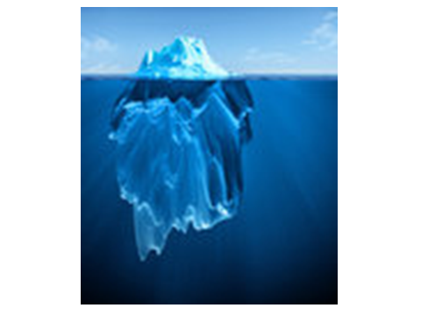

Slide 19
OT
NT
No other gods before Me.
"You shall not make for yourself an idol,
"You shall not take the name of the LORD your God in vain
"Remember the Sabbath day, to keep it holy.
"Honor your father and your mother
"You shall not murder.
"You shall not commit adultery.
"You shall not steal.
"You shall not lie.
"You shall not covet ."
(Mat 22:37 NASB) And He said to him, " 'YOU SHALL LOVE THE LORD YOUR GOD WITH ALL YOUR HEART, AND WITH ALL YOUR SOUL, AND WITH ALL YOUR MIND.'
(Mat 22:38 NASB) "This is the great and foremost commandment.
(Mat 22:39 NASB) "The second is like it, 'YOU SHALL LOVE YOUR NEIGHBOR AS YOURSELF.'
(Mat 22:40 NASB) "On these two commandments depend the whole Law and the Prophets."

Slide 20
OT
NT
No other gods before Me.
"You shall not make for yourself an idol,
"You shall not take the name of the LORD your God in vain
"Remember the Sabbath day, to keep it holy.
"Honor your father and your mother
"You shall not murder.
"You shall not commit adultery.
"You shall not steal.
"You shall not lie.
"You shall not covet ."
(Mat 22:37 NASB) And He said to him, " 'YOU SHALL LOVE THE LORD YOUR GOD WITH ALL YOUR HEART, AND WITH ALL YOUR SOUL, AND WITH ALL YOUR MIND.'
(Mat 22:38 NASB) "This is the great and foremost commandment.
(Mat 22:39 NASB) "The second is like it, 'YOU SHALL LOVE YOUR NEIGHBOR AS YOURSELF.'
(Mat 22:40 NASB) "On these two commandments depend the whole Law and the Prophets."

Slide 21
OT
Naturalism
NT
No other gods before Me.
"You shall not make for yourself an idol,
"You shall not take the name of the LORD your God in vain
"Remember the Sabbath day, to keep it holy.
"Honor your father and your mother
"You shall not murder.
"You shall not commit adultery.
"You shall not steal.
"You shall not lie.
"You shall not covet ."
(Mat 22:37 NASB) And He said to him, " 'YOU SHALL LOVE THE LORD YOUR GOD WITH ALL YOUR HEART, AND WITH ALL YOUR SOUL, AND WITH ALL YOUR MIND.'
(Mat 22:38 NASB) "This is the great and foremost commandment.
(Mat 22:39 NASB) "The second is like it, 'YOU SHALL LOVE YOUR NEIGHBOR AS YOURSELF.'
(Mat 22:40 NASB) "On these two commandments depend the whole Law and the Prophets."

Slide 22
OT
God’s given order
NT
No other gods before Me.
"You shall not make for yourself an idol,
"You shall not take the name of the LORD your God in vain
"Remember the Sabbath day, to keep it holy.
"Honor your father and your mother
"You shall not murder.
"You shall not commit adultery.
"You shall not steal.
"You shall not lie.
"You shall not covet ."
(Mat 22:37 NASB) And He said to him, " 'YOU SHALL LOVE THE LORD YOUR GOD WITH ALL YOUR HEART, AND WITH ALL YOUR SOUL, AND WITH ALL YOUR MIND.'
(Mat 22:38 NASB) "This is the great and foremost commandment.
(Mat 22:39 NASB) "The second is like it, 'YOU SHALL LOVE YOUR NEIGHBOR AS YOURSELF.'
(Mat 22:40 NASB) "On these two commandments depend the whole Law and the Prophets."

Slide 23
There is only one way to satisfy those 10 - Become like man before the fall.
Become a new creature in Christ - The plan of God leads to the cross
The 10 are not a condition for salvation but a consequence of salvation.

Slide 24
