Slide 1
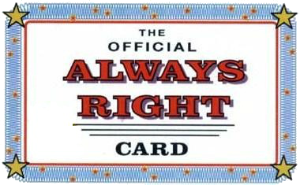

Slide 2
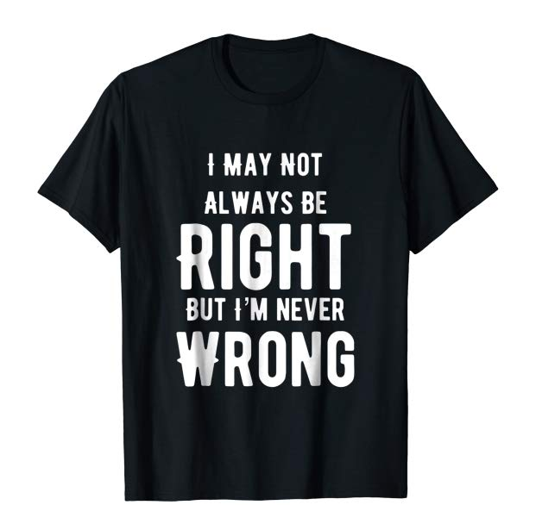

Slide 3
BEING RIGHT ABOUT RIGHTEOUSNESS

Slide 4
RIGHTEOUSNESS UNDERSTOOD
“righteousness”—conformity to a standard
Synonyms—justice, uprightness
Antonyms—unrighteousness, wickedness, evil
Who is righteous? Only God
How can we be righteous before God?
**To fail to properly understand righteousness is to fail to properly understand God

Slide 5
RIGHTEOUSNESS IMPUTED
accountant’s office and judge’s courtroom
Imputed = credited to someone’s account
Declared “righteous” in spite of sins
Christ’s righteousness credited to our accounts!
Declared righteous—judicial status changed
**Imputed righteousness doesn’t make me righteous, but rather declares me righteous

Slide 6
RIGHTEOUSNESS IMPARTED
birthday party and auto mechanic’s shop
Imparted = given, granted, bestowed (God’s gift)
New birth(day) gift—the Holy Spirit
Is also a practical lifestyle of attitudes and actions (moral)
Not dependent on me…by faith…new nature…fruit
**Imparted righteousness is the work of the Spirit to transform me into the image of Jesus Christ the righteous

Slide 7
RIGHTEOUSNESS EMBRACED
Not justified by imparted righteousness—so my standing is not dependent on my performance
Not sanctified by imputed righteousness—so I have a responsibility and real ability to say “no” & “yes”
Embrace imputed by believing on God the Son
Embrace imparted by yielding to God the Spirit
**Wrap your arms of faith around God, and you will discover that He is the one actually doing the holding

Slide 8
ARE YOU RIGHT ABOUT RIGHTEOUSNESS?
Do you understand the importance of being declared right before God? There is no entrance into heaven without imputed righteousness
Do you understand the importance of doing right before God? There is no effective life on earth without imparted righteousness

