Slide 3
RECEIVING ONE ANOTHER IN 2017
Romans 15:7

Slide 4
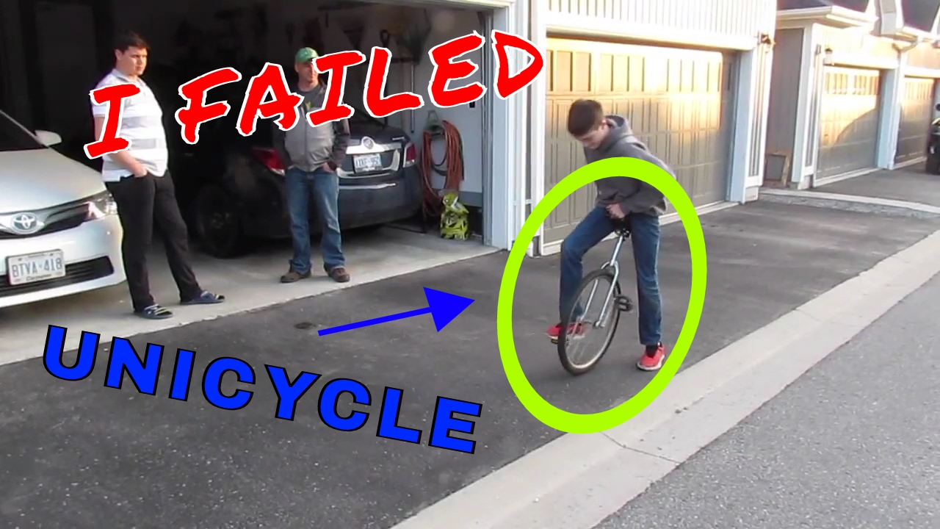
HARDER THAN IT LOOKS

Slide 5
HARDER THAN IT LOOKS
“Therefore receive one another”
Do we understand who we are to receive?
--even those who differ from us
Do we understand what it means to receive?
--take to oneself, with welcome and warmth
Do we understand into what we are receiving?
--a family, a body, a flock
Do we understand the grammar of receiving?
--to yourself, command, now

Slide 6
HARDER THAN IT LOOKS
**Receiving every “one another” is too hard for us, but nothing is too hard for God.

Slide 7
HEADIER THAN IT LOOKS

Slide 8
HEADIER THAN IT LOOKS
“just as Christ also received us”
That is WHY we are to receive one another
That is HOW we are to receive one another
“But I’m not Jesus”…Galatians 2:20
**Meditating on Christ’s reception of me should
motivate me to imitate Him by receiving one another

Slide 9
HIGHER THAN IT LOOKS

Slide 10
HIGHER THAN IT LOOKS
“to the glory of God”
Christ received us to the glory of God
We are to receive one another to the glory of God
--His purpose is displayed
--our unity declares His glory
**The highest goal for which we can aim is the glory of God

Slide 11
HOLIER & HAPPIER THAN IT LOOKS
When we receive one another, we are doing holy business for God
When we receive one another, we will ultimately experience true and deep happiness from God

Slide 12
RECEIVE ONE ANOTHER
What is God specifically calling me to do in response to this verse?
Will I…
--listen to the Father commanding me,
--look to the Son encouraging me, and
--lean on the Holy Spirit enabling me
to receive one another to God’s glory?

