Slide 2
SEEING JESUS IN JUDGES
EHUD
Judges 3:12-30

Slide 3
“In those days there was
no king in Israel;
everyone did what was right
in his own eyes.”
Judges 21:25

Slide 4
CYCLE IN JUDGES
Israel forsakes God God judges Israel
Israel enjoys freedom Israel suffers
God provides deliverance Israel cries to God

Slide 5
Look at Ehud and see Jesus reflected in 3 similarities between them…

Slide 6
SEEING JESUS IN EHUD
Both were raised up by God to address a desperate need

Slide 7
Raised up by God to address a desperate need (v.12-15a)
Return to evil
Restriction to slavery

Slide 8
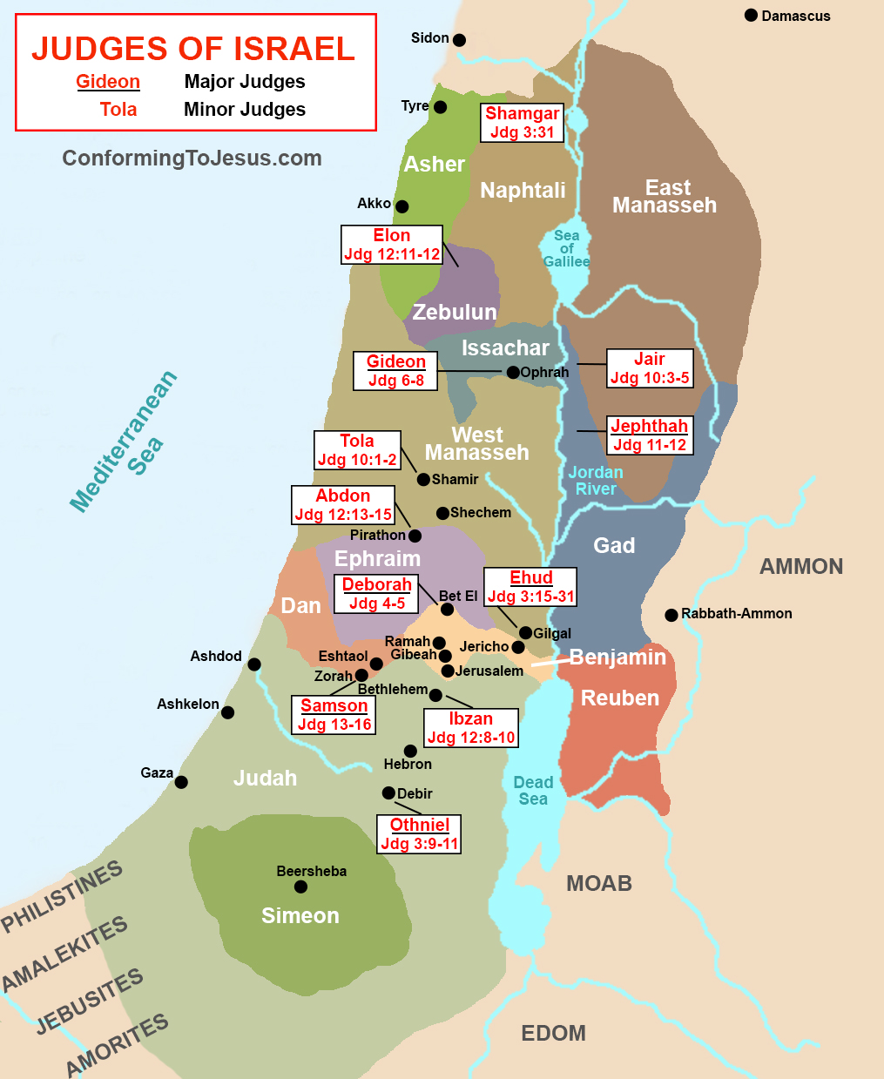

Slide 9
Raised up by God to address a desperate need (v.12-15a)
Return to evil
Restriction to slavery
Response to discipline
Reception of a deliverer
**The constant attacks from within our own humanness reveal a desperate need for the only one who can deliver us from the body of this death— our Lord Jesus Christ

Slide 10
SEEING JESUS IN EHUD
Both were raised up by God to address a desperate need
Both defeated the enemy with a concealed weapon

Slide 11
Ruined the enemy with a concealed weapon (v.15b-22)
Crafted weapon
Concealed weapon
Solo weapon
Divine weapon
Effective weapon
**The only weapon that is guaranteed in battling the flesh is the very weapon employed by the only undefeated Warrior—the Sword of the Spirit

Slide 12
SEEING JESUS IN EHUD
Both were raised up by God to address a desperate need
Both defeated the enemy with a concealed weapon
Both return to secure a long-term victory

Slide 13
Return to secure a long-term victory (v.23-30)
Preceded by a quiet departure
Proclaimed by a loud declaration
Presented as a one-sided defeat
Preliminary to an extended peace
**Our only hope for a truly long-term victory over our flesh is our great God and Savior Jesus Christ

Slide 14
SEEING JESUS
What did you see of Jesus in Ehud that you want to meditate on throughout the day and week ahead?
Until I see my flesh as a determined and persistent enemy, God’s Word as my secret weapon, and the Lord Jesus as my only hope, I will continue to live in slavery and defeat.
“But now we do not yet see all things put under him. But we see Jesus…(Hebrews 2:8-9)

