Slide 1
DO YOU RECOGNIZE YOUR LEADERS?
1Thessalonians 5:12

Slide 2
WHAT ARE ELDERS?
God’s design for leadership in the local church
--not designed to be a one-person government
--not designed to be a democracy
--designed to be governed by a plurality (group) of leaders
**God’s design is always the best (and only acceptable) design

Slide 3
WHAT DO ELDERS DO?
As elders, they LEAD…
--by setting direction
--by making decisions
--by being models

Slide 4
WHAT DO ELDERS DO?
As overseers, they WATCH…
--with an awareness of the whole church
--with an awareness of dangers to the church

Slide 5
WHAT DO ELDERS DO?
As shepherds…

Slide 6
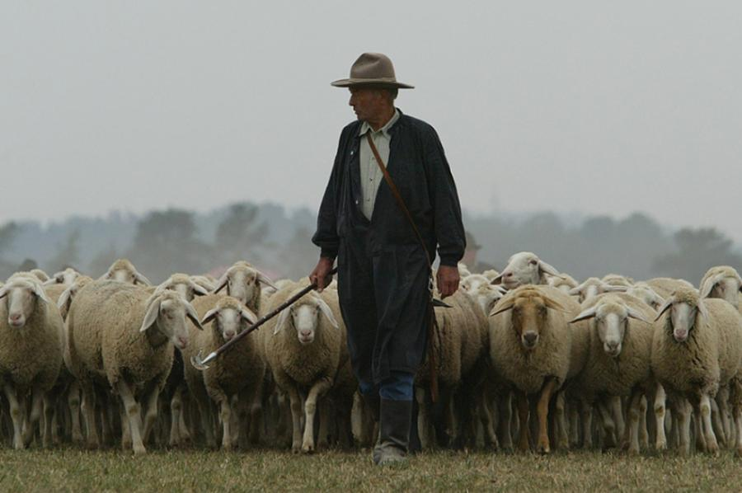

Slide 7
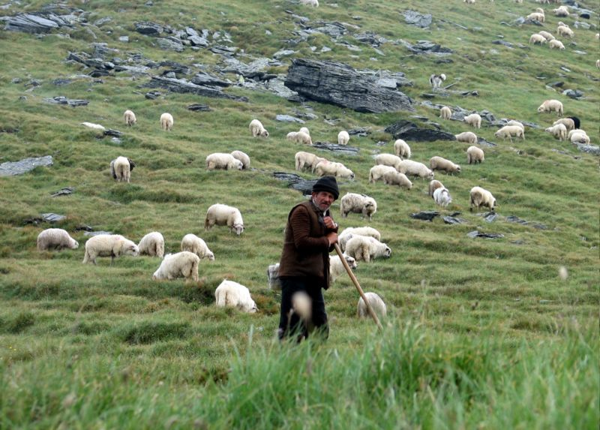

Slide 8
WHAT DO ELDERS DO?
As shepherds, they CARE FOR…
--thru feeding with the Word of God
--thru coming alongside to minister to needs
--thru praying for and with the sheep

Slide 9
WHAT DO ELDERS DO?
As elders, they LEAD…what they think (mind)
As overseers, they WATCH…what they see (eyes)
As shepherds, they CARE FOR…what they feel (heart)
**Leading, overseeing, and shepherding is a labor of love

Slide 10
WHY DO ELDERS SERVE?
NOT a desire for power or prestige
SHOULD BE motivated by:
--sincere concern for the flock
--true desire to honor the Chief Shepherd
**A man who seeks a position for power is not to be entrusted with the flock purchased with the blood of the Lord Jesus

