Slide 1
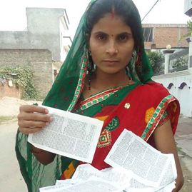
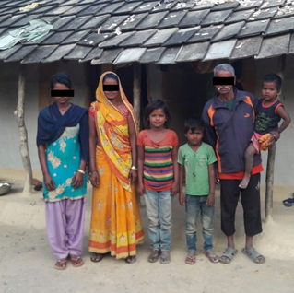
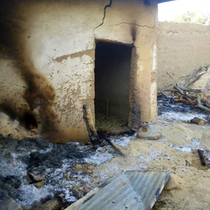
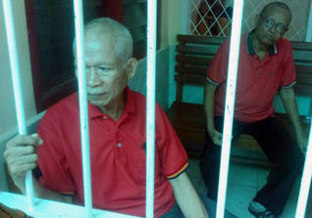

Slide 2
In 2019

Slide 3
Worship More
Worship—recognizing, acknowledging, and expressing the infinite superiority of God

Slide 4
LIKE THE PERSECUTED CHURCH

Slide 5
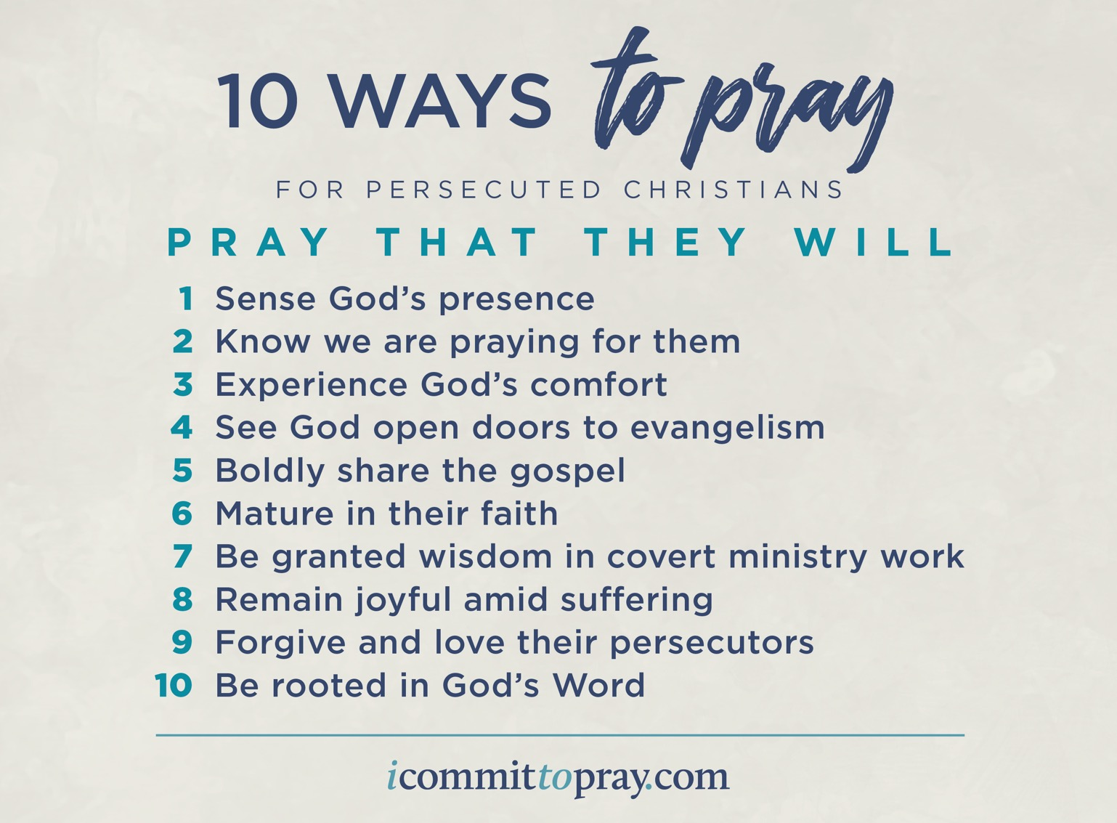

Slide 6
Worship More
Worship—recognizing, acknowledging, and expressing the infinite superiority of God
3 ways that our worship can be “more” by learning from the persecuted church

Slide 7
Worship That Is More Focused
Recognition that worship is not primarily about the worshiper (me), but about the worshiped (God)
Tendency is to focus on ourselves and how worship makes us feel
Persecuted church’s suffering brings the Lord into clearer focus--He is worth it

Slide 12
Worship That Is More Focused
Recognition that worship is not primarily about the worshiper (me), but about the worshiped (God)
Tendency is to focus on ourselves and how worship makes us feel
Persecuted church’s suffering brings the Lord into clearer focus--He is worth it
Compare Paul (Ephesians 6:20; 1:1-14)
**Will you commit to pray for the persecuted church, with a secondary goal bring a refocusing of your own worship?

Slide 13
Worship That Is More United
Recognition that worship is not merely an individual activity, but is a corporate endeavor as well
Tendency for us to consider worship as personal and private, or possibly only as wide as the local church
Persecuted church understands their need for the entire body of Christ—not independent or self-sufficient

Slide 14
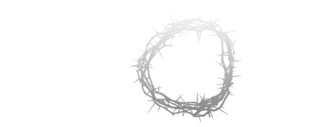
ONE FAITH
ONE FAMILY
INTERNATIONAL DAY OF PRAYER FOR THE PERSECUTED CHURCH

Slide 15
Worship That Is More United
Recognition that worship is not merely an individual activity, but is a corporate endeavor as well
Tendency for us to consider worship as personal and private, or possibly only as wide as the local church
Persecuted church understands their need for the entire body of Christ—not independent or self-sufficient
Compare Peter (1Peter 2:1-10)
**Will you commit to exposing yourself to the needs of the persecuted church, desiring your worship to rise with theirs?

Slide 16
Worship That Is More Costly
Recognition that worship is not ultimately only an offering, but an offering that is sacrificial
Tendency to view worship as comfortable and convenient
Persecuted church doesn’t have that luxury
--can cost them their health, job, family, freedom, life

Slide 19
Closing Point

Slide 20
Closing Point

Slide 21
Worship That Is More Costly
Recognition that worship is not ultimately only an offering, but an offering that is sacrificial
Tendency to view worship as comfortable and convenient
Persecuted church doesn’t have that luxury
--can cost them their health, job, family, freedom, life
Compare David (2Samuel 24:24)
**Will you commit to sacrificing for the persecuted church, reminding yourself of the value of costly worship?

Slide 22
Worship More Like the Persecuted Church
Worship that is more focused (God)
Worship that is more united (others)
Worship that is more costly (self)
What is God calling you to change regarding your relationship with the persecuted church, and in your worship?

