Slide 1
The Light of the World

Slide 2
Mark 10:46-52
“And they came to Jericho. And as he was leaving Jericho with his disciples and a great crowd, Bartimaeus, a blind beggar, the son of Timaeus, was sitting by the roadside. ⁴⁷ And when he heard that it was Jesus of Nazareth, he began to cry out and say, “Jesus, Son of David, have mercy on me!” ⁴⁸ And many rebuked him, telling him to be silent. But he cried out all the more, “Son of David, have mercy on me!”

Slide 3
⁴⁹ And Jesus stopped and said, “Call him.” And they called the blind man, saying to him, “Take heart. Get up; he is calling you.” ⁵⁰ And throwing off his cloak, he sprang up and came to Jesus. ⁵¹ And Jesus said to him, “What do you want me to do for you?” And the blind man said to him, “Rabbi, let me recover my sight.” ⁵² And Jesus said to him, “Go your way; your faith has made you well.” And immediately he recovered his sight and followed him on the way.

Slide 4
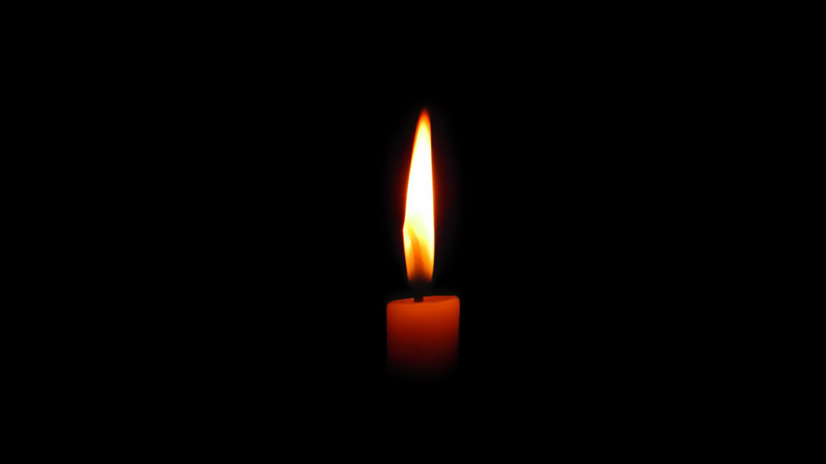

Slide 5
Mark 10:46-52
“And they came to Jericho. And as he was leaving Jericho with his disciples and a great crowd, Bartimaeus, a blind beggar, the son of Timaeus, was sitting by the roadside. ⁴⁷ And when he heard that it was Jesus of Nazareth, he began to cry out and say, “Jesus, Son of David, have mercy on me!” ⁴⁸ And many rebuked him, telling him to be silent. But he cried out all the more, “Son of David, have mercy on me!”

Slide 6
Mark 10:46-52
“And they came to Jericho. And as he was leaving Jericho with his disciples and a great crowd, Bartimaeus, a blind beggar, the son of Timaeus, was sitting by the roadside. ⁴⁷ And when he heard that it was Jesus of Nazareth, he began to cry out and say, “Jesus, Son of David, have mercy on me!” ⁴⁸ And many rebuked him, telling him to be silent. But he cried out all the more, “Son of David, have mercy on me!”

Slide 7
Mark 10:46-52
“And they came to Jericho. And as he was leaving Jericho with his disciples and a great crowd, Bartimaeus, a blind beggar, the son of Timaeus, was sitting by the roadside. ⁴⁷ And when he heard that it was Jesus of Nazareth, he began to cry out and say, “Jesus, Son of David, have mercy on me!” ⁴⁸ And many rebuked him, telling him to be silent. But he cried out all the more, “Son of David, have mercy on me!”

Slide 8
⁴⁹ And Jesus stopped and said, “Call him.” And they called the blind man, saying to him, “Take heart. Get up; he is calling you.” ⁵⁰ And throwing off his cloak, he sprang up and came to Jesus. ⁵¹ And Jesus said to him, “What do you want me to do for you?” And the blind man said to him, “Rabbi, let me recover my sight.” ⁵² And Jesus said to him, “Go your way; your faith has made you well.” And immediately he recovered his sight and followed him on the way.

Slide 9
⁴⁹ And Jesus stopped and said, “Call him.” And they called the blind man, saying to him, “Take heart. Get up; he is calling you.” ⁵⁰ And throwing off his cloak, he sprang up and came to Jesus. ⁵¹ And Jesus said to him, “What do you want me to do for you?” And the blind man said to him, “Rabbi, let me recover my sight.” ⁵² And Jesus said to him, “Go your way; your faith has made you well.” And immediately he recovered his sight and followed him on the way.

Slide 10
⁴⁹ And Jesus stopped and said, “Call him.” And they called the blind man, saying to him, “Take heart. Get up; he is calling you.” ⁵⁰ And throwing off his cloak, he sprang up and came to Jesus. ⁵¹ And Jesus said to him, “What do you want me to do for you?” And the blind man said to him, “Rabbi, let me recover my sight.” ⁵² And Jesus said to him, “Go your way; your faith has made you well.” And immediately he recovered his sight and followed him on the way.

Slide 11
⁴⁹ And Jesus stopped and said, “Call him.” And they called the blind man, saying to him, “Take heart. Get up; he is calling you.” ⁵⁰ And throwing off his cloak, he sprang up and came to Jesus. ⁵¹ And Jesus said to him, “What do you want me to do for you?” And the blind man said to him, “Rabbi, let me recover my sight.” ⁵² And Jesus said to him, “Go your way; your faith has made you well.” And immediately he recovered his sight and followed him on the way.

Slide 13
Luke 2:29-32 “Lord, now you are letting your servant depart in peace, according to your word; ³⁰ for my eyes have seen your salvation ³¹ that you have prepared in the presence of all peoples, ³² a light for revelation to the Gentiles, and for glory to your people Israel.”

Slide 14
John 1:1-11 “In the beginning was the Word, and the Word was with God, and the Word was God. ² He was in the beginning with God. ³ All things were made through him, and without him was not any thing made that was made. ⁴ In him was life, and the life was the light of men. ⁵ The light shines in the darkness, and the darkness has not overcome it.

Slide 15
⁶ There was a man sent from God, whose name was John. ⁷ He came as a witness, to bear witness about the light, that all might believe through him. ⁸ He was not the light, but came to bear witness about the light. ⁹ The true light, which gives light to everyone, was coming into the world. ¹⁰ He was in the world, and the world was made through him, yet the world did not know him. ¹¹ He came to his own, and his own people did not receive him.”

Slide 16
John 8:12 “Again Jesus spoke to them, saying, “I am the light of the world. Whoever follows me will not walk in darkness, but will have the light of life.”

Slide 17
Ephesians 4:17-18 “Now this I say and testify in the Lord, that you must no longer walk as the Gentiles do, in the futility of their minds. ¹⁸ They are darkened in their understanding, alienated from the life of God because of the ignorance that is in them, due to their hardness of heart.”

Slide 18
Romans 1:18-21 “For the wrath of God is revealed from heaven against all ungodliness and unrighteousness of men, who by their unrighteousness suppress the truth. ¹⁹ For what can be known about God is plain to them, because God has shown it to them.

Slide 19
²⁰ For his invisible attributes, namely, his eternal power and divine nature, have been clearly perceived, ever since the creation of the world, in the things that have been made. So they are without excuse. ²¹ For although they knew God, they did not honor him as God or give thanks to him, but they became futile in their thinking, and their foolish hearts were darkened.”

Slide 20
2 Corinthians 4:4-6 “In their case the god of this world has blinded the minds of the unbelievers, to keep them from seeing the light of the gospel of the glory of Christ, who is the image of God. ⁵ For what we proclaim is not ourselves, but Jesus Christ as Lord, with ourselves as your servants for Jesus' sake.

Slide 21
⁶ For God, who said, “Let light shine out of darkness,” has shone in our hearts to give the light of the knowledge of the glory of God in the face of Jesus Christ.”

Slide 22
Acts 26:18 “to open their eyes, so that they may turn from darkness to light and from the power of Satan to God, that they may receive forgiveness of sins and a place among those who are sanctified by faith in me.”

Slide 23
1 Peter 2:9 “But you are a chosen race, a royal priesthood, a holy nation, a people for his own possession, that you may proclaim the excellencies of him who called you out of darkness into his marvelous light.”

